Slide 1
Presentation on Online Surface Water Information System (eSWIS)
by
Rajesh Kumar, Director Central Water Commission
New Delhi

Slide 2
Existing System
Consists of following 3 different Software’s :
SWDES 3.0
Current desktop based data entry application.
HYMOS
Current application for secondary data validation.
WISDOM
Current application for data dissemination.

Slide 3
Existing System
SWDES 3.0
Stand-alone software.
Requires installation. One local database file is installed every time.
Updating-software is a tedious process.
Tough data integration from field to software: manually data reception and registration.
Registered-data need to be sent from every place in order to put it all together.
The entire process requires long time and efforts.

Slide 4
Existing System
HYMOS
Commercial-software. Not available everywhere due to physical-license issues.
Proprietary software.
Dataflow is not fully integrated. Data need to be exported from SWDES.
WISDOM
Outdated software, runs only in Window 97 version
Difficult to maintain

Slide 5
Development of Surface Water Information System (e-SWIS)
Work was awarded to M/s EPTISA, Spain on 19-11-2012.
Complete work is divided in three parts:
1. Supply, installation and Commissioning
2. Hosting and maintenance of eSWIS on internet during warranty period
3. Post warranty AMC of eSWIS system
Completion period for Part-1 is 12 months, their after 3 years warranty and 7 years post warranty AMC are proposed.

Slide 6
Objective
Replacement of current Surface Water Data Entry System (SWDES), Water Information System domain (WISDOM) and HYMOS from Desktop based software's to Open source web based software, keeping the current functionality and adding new functionalities.

Slide 7
Broad Features
Based on web and desktop applications
Data and functionality will be integrated.
Easy access to information to users.
Easy backup procedure.
Complete security control over data and functionality
Data can be entered from anywhere.
Data access will be controlled and restricted to authorized users.
Time from data-entering to data-dissemination will be largely decreased.
Data can be entered offline and it will be sent when online connection is available.

Slide 8
Benefit & Strength
Strengths | Benefits
Data and functionality will be integrated in an unique system Data will be managed and will be stored in a central repository | Users will be able to access common information at the same time from anywhere
Functionality will be available from anywhere with just an Internet connection Data could also be entered offline and to be sent to the central repository when online connection is available | Users will be able to work at any time from anywhere
System upgrading functionality will be easier and directly available for all the users | All the users will work with the same software version
Complete security control over data and functionality Each user will be able to do the tasks according to his profile | Each profile user will have their own access limitations based on their level of responsability
Easy backup procedure System will be available 24x7x365 | The system will be available at any time
There will be a staff structure for the maintenance of the systems, software and data Warranty and post-warranty will be provided for a period of 10 years | Users will continuously have support from experienced staff
Time from data-entering to data-dissemination will be broadly decreased | Latest Data will be available online for the users in a short time

Slide 9
Contd..
Administrative hierarchy – Various Administrative Hierarchy for all Implementing Agencies including CWC has been created and can be accessed as per permission granted. New user can be added in this hierarchy.
Geographical hierarchy- Details of Basin, Rivers, Tributaries, Sub-tributary has been created and is editable.
Administrative Divisions- Details of Regional Offices of IA’S has been created and is editable.
Various reports can be generated.
Based on above hierarchies different level users can be created with separate login ID and password.

Slide 10
eSWIS- Security Features
Web hosting to maintain the web application at a Tier III, ISO- 20000-1 and ISO 27000 certified server farm/data center. The system is completely secured from the all types of internet threats.
The highest level of user is system administrator, who will be able to create users and groups of users and assign permissions to access data and functionality.
It is possible for the administrator to assign, for example, permission for a user to see all CWC hydrological data but only permission to edit the data for the basin(s) in which he/she works.
The eSWIS provides a simple login and password facility to access data for which access permissions assigned by the administrator.

Slide 11
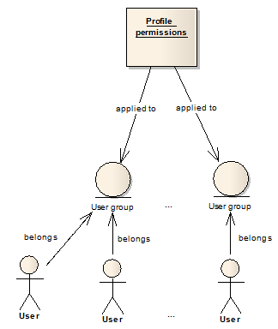
Security management | Data Security
Data flow among the system and final user will be encrypted at all times
In order to protect data-access, the new eSWIS is based on a system which manages the following entities:
Profiles
User groups
Users
Profile assignment
Facility access level
Data permission level
Module access level

Slide 12
Users
Data Entry Operator | A data entry operator can enter data and can save it and application will show “Data is pending for approval”, and the data will be saved in a secondary database.
Data In-charge | A data in-charge have the same access level of permission as data entry operator and in addition he/she can approve data and only approved data will be stored in main database.
Admin | An admin have permission to access all the modules.

Slide 13
Login to eSWIS: https://180.92.171.80/eSWDES

Slide 14
Home Page

Slide 15
Security: To Manage Users

Slide 16
Security : To add a User

Slide 17
Security :To create a Group

Slide 18
eSWIS- Modules
Static/Semi Static Characteristics Module
Meteorological Module
Hydrological Module
Sediment Module
Water Quality Module
Snow Module
Flood Forecast Module
Reservoir/Diversion Scheme Module
Data Validation Module
Data Availability Module
Import/ Export
Flood Dissemination Module

Slide 19
Static/Semi Static Characteristics Module
Static information about the station, creation of new stations
Static information for Current Meter
Series for different parameters with different frequency for which data is to be maintained
Cross-section data
Elevation- Area Capacity curve
Record of Reduced level/Zero of gauge
Salient features of Reservoir
Generation of various reports

Slide 20
Static/Semistatic Characteristics

Slide 21
To Manage States, Districts, Tahsils and Cities

Slide 22
To Manage Rivers

Slide 23
To Manage Divisions, Agencies

Slide 24
To Manage Parameters

Slide 25
Station Management

Slide 26
Series Management

Slide 27
Current Meter Characteristics

Slide 28
Reduced Level of Zero of the Gauge

Slide 29
X-Section

Slide 30
Meteorological Module
Rainfall
Temperature
Pressure
Humidity
Wind
Evaporation
Sunshine hours
Data for all meteorological parameters can be entered either parameter wise or all climatic data at one place.
Data frequency is dynamic
Provision of primary validation
Graphical view is generated while entering the data
Basic statistical function is available
Various reports including validation report can be generated
Comparison tools are available

Slide 31
Meteorological Module

Slide 32
Rainfall Daily Data Entry

Slide 33
Yearly Report of Daily Rainfall

Slide 34
Hydrological Module
Water Level
Discharge
Data for all Hydrological parameters can be entered
Data frequency is dynamic
Provision of primary validation
Graphical view is generated while entering the data
Basic statistical function is available
Various reports including validation report can be generated
Comparison tools are available

Slide 35
Hydrological Module

Slide 36
Water Level Data Entry

Slide 37
Data Entry Form for Flow Measurement

Slide 38
Stage Discharge Data Entry

Slide 39
Sediment Module
Data for all Sediment parameters can be entered
Data frequency is dynamic
Provision of primary validation
Basic statistical function is available
Various reports including validation report can be generated
Comparison tools are available

Slide 40
Sediment Module

Slide 41
Data Entry for Suspended Sediment

Slide 42
Data Entry for Suspended Sediment Summery

Slide 43
Water Quality Module
Information of WQ Labs can be entered
Data for all WQ parameters can be entered
Data frequency is dynamic
Basic statistical function is available
Various reports including validation report can be generated
Comparison tools are available
Various reports viz to viz different standard is available

Slide 44
Water Quality Module

Slide 45
Data Entry for Laboratory Information

Slide 46
Data Entry for Parameter Information

Slide 47
Report for Parameter Information

Slide 48
Snow Module
Data for all snow parameters can be entered either parameter wise or all parameter at one place
Data frequency is dynamic
Provision of primary validation
Graphical view is generated while entering the data
Basic statistical function is available
Various reports including validation report can be generated
Comparison tools are available

Slide 49
Snow Module

Slide 50
Data Entry for Snow

Slide 51
Graph Compare

Slide 52
Flood Forecasting Module
Data for all base and flood forecasting station can be entered
Data of Inflow and level forecast can be entered
Data frequency is dynamic
Provision of primary validation
Graphical view is generated while entering the data
Basic statistical function is available
Various reports including validation report can be generated
Comparison tools are available

Slide 53
Flood Forecast Module

Slide 54
Data Entry for Level Forecast

Slide 55
Data Entry for Inflow Forecast

Slide 56
Data Entry for Flood Data

Slide 57
Various Flood Forecast reports

Slide 58
Report- Daily Flood Bulletin issued by CFCR

Slide 59
Weekly Report prepared by Division

Slide 60
Flood Dissemination Module
List based Dissemination
Map Based Dissemination
Current Flood Situation
Flood Bulletins
Unprecedented flood situations
Flood Hydrograph
Displaying both original and revised forecasts.
Sending reports as SMS to a defined list of mobile phone numbers through the service provider as engaged by CWC.
Sending reports as emails to a defined list of email addresses
Generating the SMS of special flood situation as defined and in the format as designed by the divisional/central administrator

Slide 61
Flood Forecasting Web Site | URL: http://www.india-water.gov.in/ffs

Slide 62
Flood Forecasting Web Site | URL: http://www.india-water.gov.in/ffs

Slide 63
Static/Semi-static Characteristics | URL: http://www.india-water.gov.in/ffs

Slide 65
Flood Forecasting Bulletins | URL: http://www.india-water.gov.in/ffs

Slide 67
Static/Semi-static Characteristics | About the Project

Slide 70
Static/Semi-static Characteristics | About the Project

Slide 71
Static/Semi-static Characteristics | About the Project

Slide 72
Mobile Application for Stage Discharge Summery

Slide 73
Reservoir Module
Data for all reservoir monitoring station can be entered
Data frequency is dynamic
Provision of primary validation
Graphical view is generated while entering the data
Basic statistical function is available
Various reports including validation report can be generated
Comparison tools are available

Slide 74
Salient Feature of Reservoir

Slide 75
Data Validation Module
For Primary and Secondary Validation of the data
Advanced statistical function is available
Various validation report can be generated
Comparison tools are available
Stage-Discharge curve can be generated

Slide 76
Secondary Validation
1. Validation a. Tests on timing errors i) Facility to display several stations side by
side to detect timing errors b. Inspection of temporal variation i) Graphical display of multiple station data
in single graph, i.e. flow + rainfall ii) Graphical display of residual series,
residual mass curves

Slide 77
c. Inspection of longitudinal/spatial variation
i) Tabular and graphical display of data along a profile ii)Graphical display of variables on a map d. Test of relations
i) Scatter plots between variables
ii) Time series relations by regression, including time
shifts, regression of multiple variables, including
flow/discharge
e. Double mass analysis
i) Comparison of time series to aggregated or averaged
groupings of other series
f. Hydrological validation
i) Volume and time distribution comparisons between
observed runoff and basin rainfall

Slide 78
2. Data correction a. Data correction i) Linear Interpolation of missing values ii) Use of regression relations iii) Constant correction across a range of values iv) Drift correction across a range of values v) Time-shifting data 3. Processing a. Fitting rating equations i) Simple equations ii) Complex equations, including backwater corrections,
shifts due to scour and deposition, unsteady flow iii) Calculations for standard weirs and flumes b. Extrapolation of rating equations i) Logarithmic extrapolation, stage-area stage-velocity,
Chezy & Manning equations

Slide 79
c. Validation of rating equations i) Test new data against existing ratings d. Hydraulic computations i) Calculation of backwater effects by observations
of levels and cross sections at downstream points e. Stage-Discharge Computations i) Calculate discharge from stage by calculated
ratings f. Establishment of sediment rating equation i) Calculation of sediment ratings in a similar manner
to discharge

Slide 80
Data compilation a. Aggregation and disaggregation i) Transformation of data by aggregation or disaggregation
to different time intervals b. Creation of derived series i) Minima, maxima, peak over threshold c. Computation of areal rainfall i) Basin rainfall by station weights, Theissen polygons,
Kriging d. Evapotranspiration i) Calculation of PE from meteorological observations

Slide 81
Secondary Validation
URL: http://180.92.171.80/eSWDESSV

Slide 82
Select Stations By Location

Slide 83
Create a New SCENARIO: Click Add to scenario

Slide 84
Save Scenario

Slide 85
Load Scenario

Slide 86
Modules of Secondary validation
SECONDARY VALIDATION:
Time Series Analysis
Gap Filling and Correction
Stage-Discharge
Compilation and Generation
Sediment rating Equation

Slide 87
Time Series Analysis :Sub Modules
Time Series Analysis :
General Inspection of Series :
Graphical Analysis
Inspection of Values
Computation of Relation Curve
Inspection Longitudinal variation
Double Mass Analysis
Other Analysis

Slide 88
Graphical Analysis

Slide 89
Inspection of value

Slide 90
Inspection of value

Slide 91
Computation of Relation Curve

Slide 92
Inspection Longitudinal variation

Slide 93
Double Mass Analysis

Slide 94
Other Analysis: Residual Series

Slide 95
Other Analysis : Balamce

Slide 96
Gap Filling & Correction
Gap Filling & Correction :
Relation Curve
Constant Correction
Using Existing records
Shifting
Drift Correction

Slide 97
Relation Curve

Slide 98
Constant Correction

Slide 99
Using Existing Record

Slide 100
Shifting

Slide 101
Drift Correction

Slide 102
Stage-Discharge
Stage-Discharge :
Fitting ratting Curves
Validation of Rating Equations
Extrapolation of Rating Curve
Stage-Discharge Computation

Slide 103
Fitting of ratting Curves :PART I

Slide 104
Fitting of ratting Curves : PART II

Slide 105
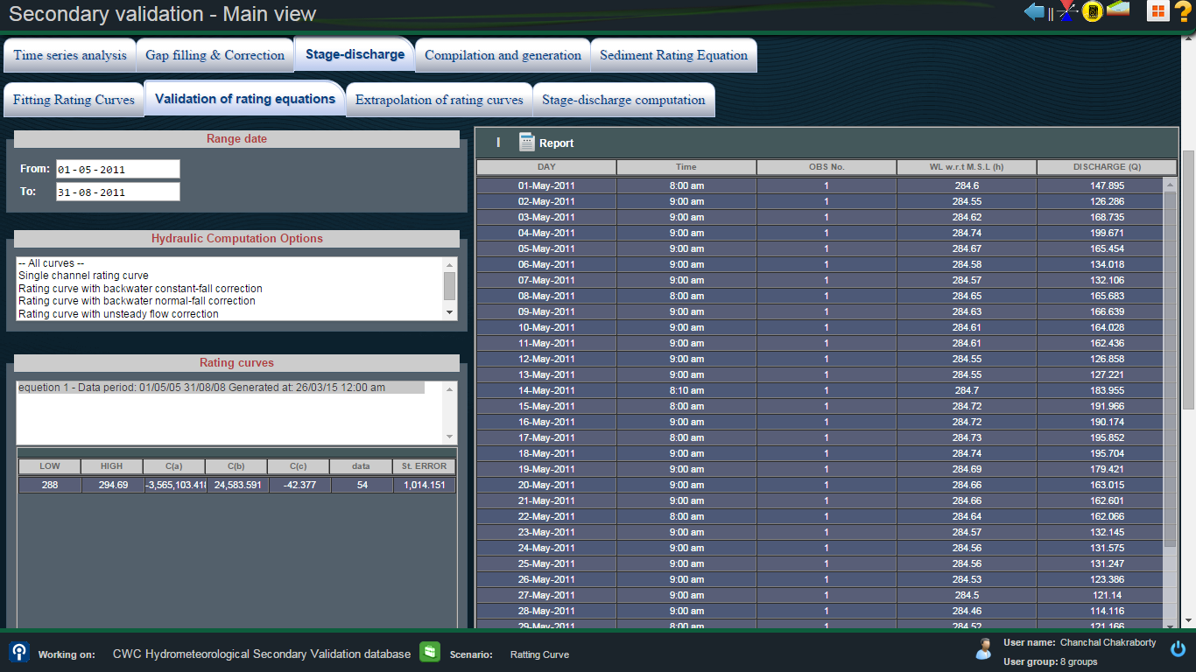
Validation of rating Equation : PART I

Slide 106
Validation of rating Equation : PART II

Slide 107
Extrapolation of rating curve
Stage-Discharge :
Logarithmic Scale Method
Stage-Area Velocity
Manning Cross-section Properties
With Rating Curve

Slide 108
Logarithmic Scale Method

Slide 109
Stage –Area Velocity

Slide 110
Manning Cross-Section Properties

Slide 111
With Rating Curve

Slide 112
Stage-Discharge Computation
Stage Discharge Computation:
With Rating Curve
Weirs and Flumes

Slide 113
With Rating Curves

Slide 114
Weirs & Flumes

Slide 115
Compilation And Generation
Compilation And Generation
Aggregation
Disaggregation
Creation of Derived Series
Computation of Areal Rainfall
Calculation of Evatranspitation

Slide 116
Aggregation

Slide 117
Disaggregation

Slide 118
Creation of Derived Series

Slide 119
Computation of Areal Rainfall

Slide 120
Calculation of evapotranspiration

Slide 121
Sediment Rating Equation
Sediment Rating Equation :
Fitting Rating Curves
Computation of Sediments

Slide 124
Import & Export
Facility for importing data from various formats such as Excel, IMD, SWDES is available.
Facility for exporting data to various formats such as Excel, Mike-11 etc is available.
Various report such as year books etc can be generated.

Slide 125
Data Dissemination
Web based metadata catalogue
Metadata and data availability for all stations is available on-line, but permissions for accessing actual data will be subject to control by the administrator.
User will be able to view various details like name of station or agency to which station belong, type of observations taken at station, period of data availability etc for both map based and list based options.
The catalogue will show station of different IAs/States separately and also in different possible combinations such as in a single basin user shall have the option to select agencies, type of stations, state/IAs etc. or any of them.
This module will be available for all the people and will not require a login. It allows querying and searching all metadata/information available.
user can order requisite data.

Slide 126
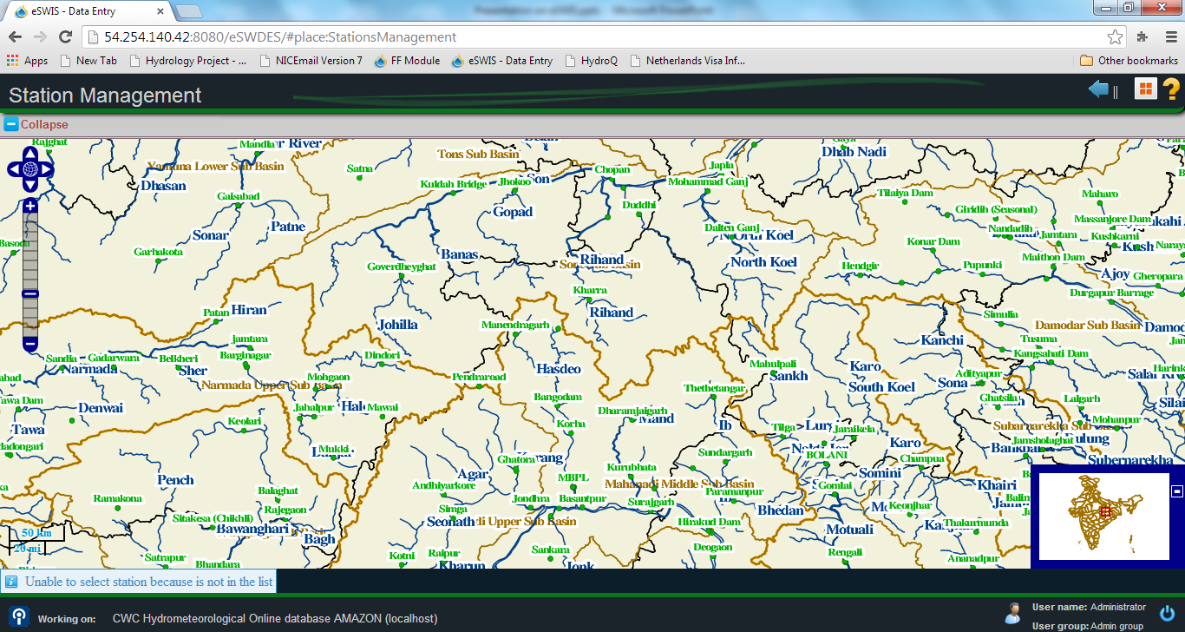
Representation of HO site on Map

Slide 127
Data Dissemination URL: http://180.92.171.80/wsdd

Slide 128
Add Metadata for the station

Slide 129
Publish the Approved Data

Slide 130
Category of Users
Website address for data entry: https:\\180.92.171.80/eSWDES
With secondary validation: 180.92.171.80/eSWDESSV
For Flood Forecasting application: www.india-water.gov.in/ffs
Mobile Application: https:\\180.92.171.80/eSWDES/eswdes-mobile.html
Feedback of eSWIS can be mailed at: eswis.feedback@gmail.com
Support team of eSWIS:
Email id: rdcdte-cwc@nic.in
Telephone No.: 011-26100285
Fax No.: 011-26181267
Mobile No.: 09868207648 (Mr. N.K.Manglik, Director, River Data Dte., CWC)
09871356330 (Mr. Chanchal Chokerbortey, M/s Eptisa)

Slide 131
THANKS

Slide 132
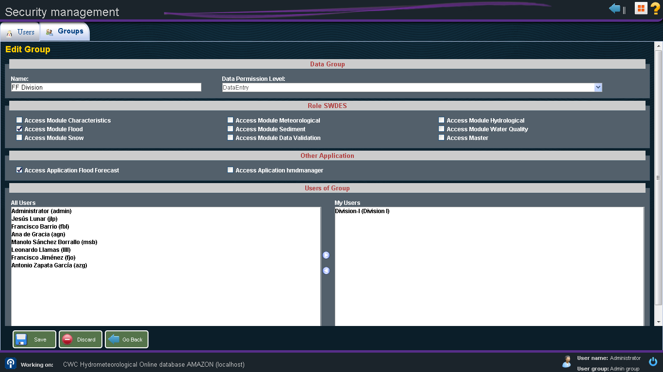
Security management

Slide 133
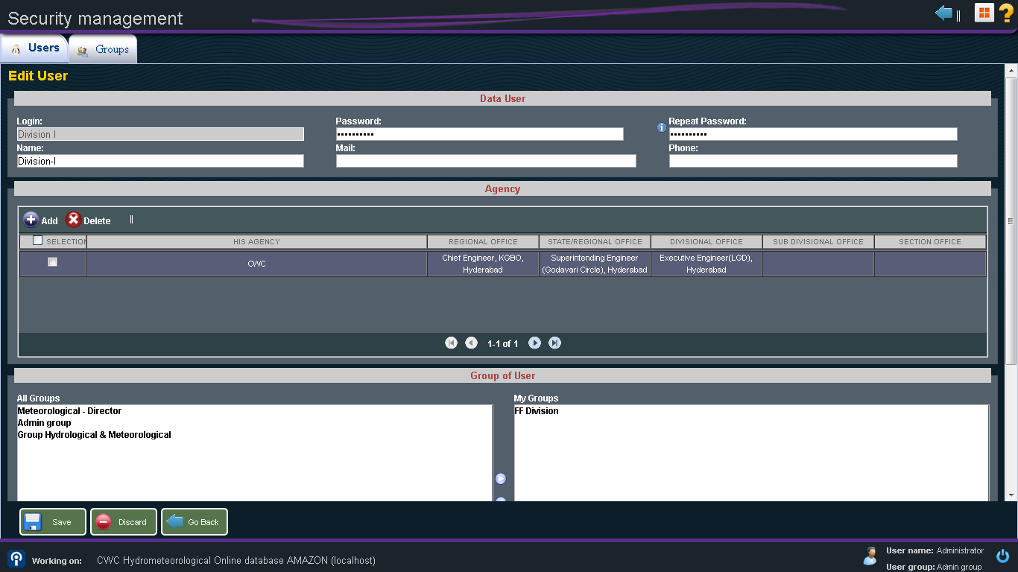
Security management

Slide 134
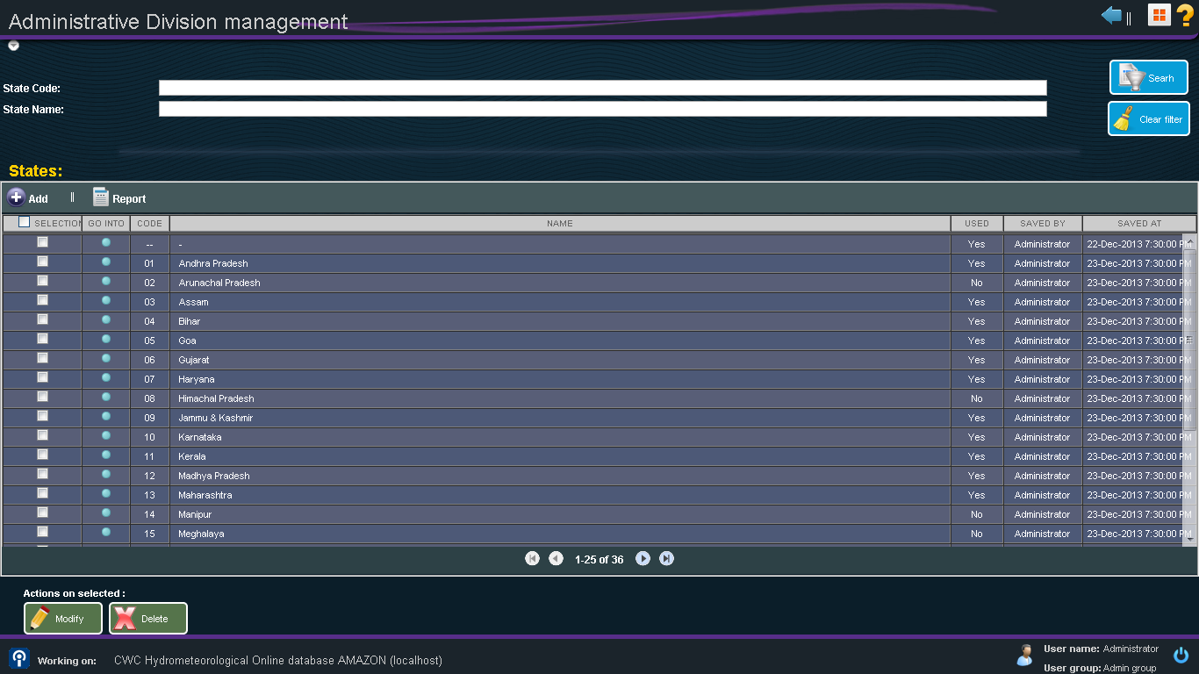
Administrative Division management

Slide 135
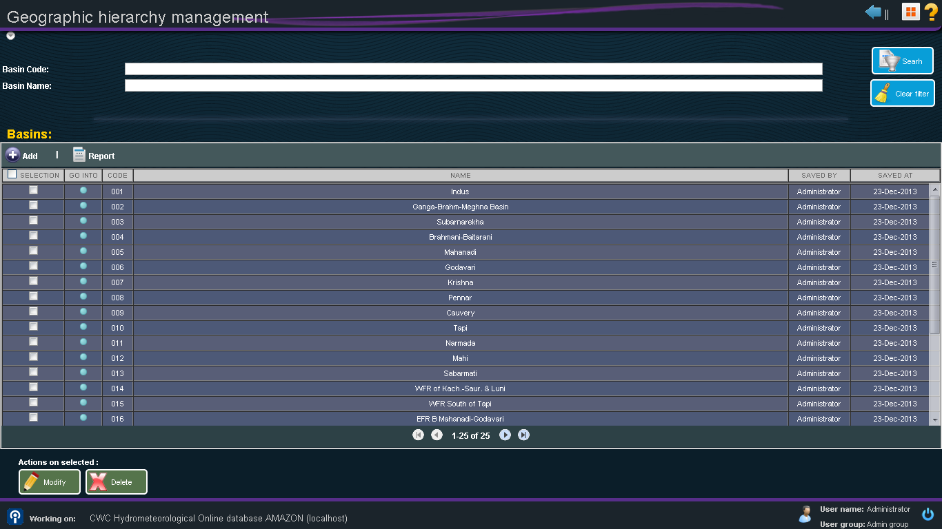
Geographic hierarchy management

Slide 136
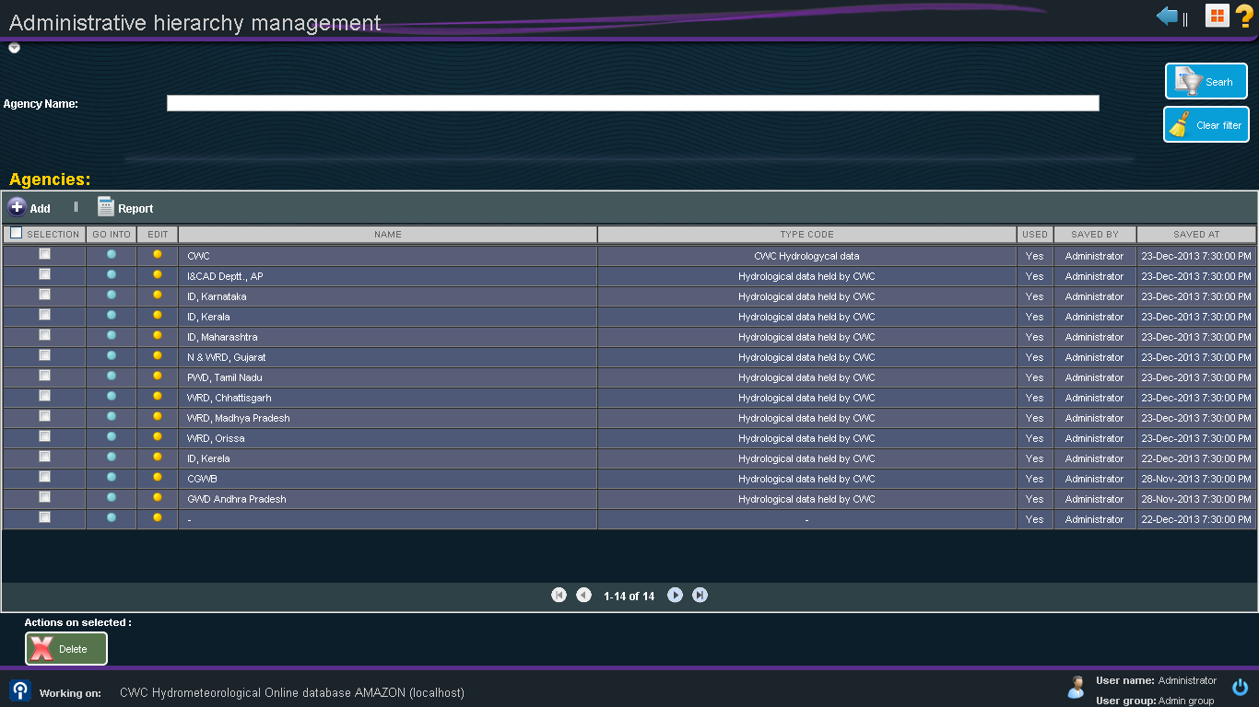
Administrative hierarchy management

Slide 137
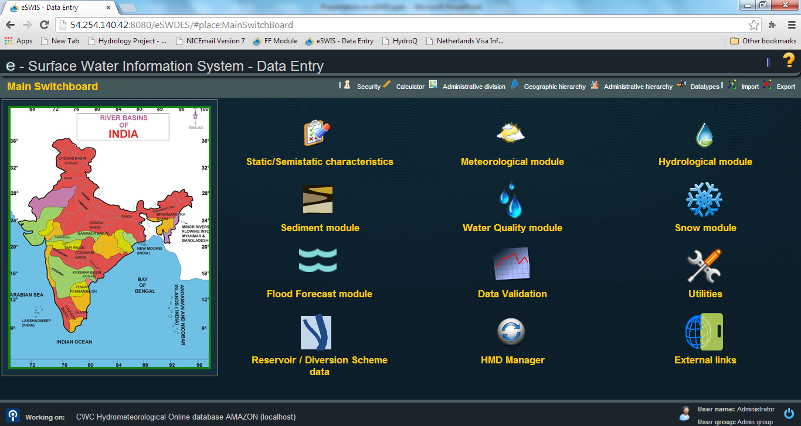
eSWIS

Slide 138
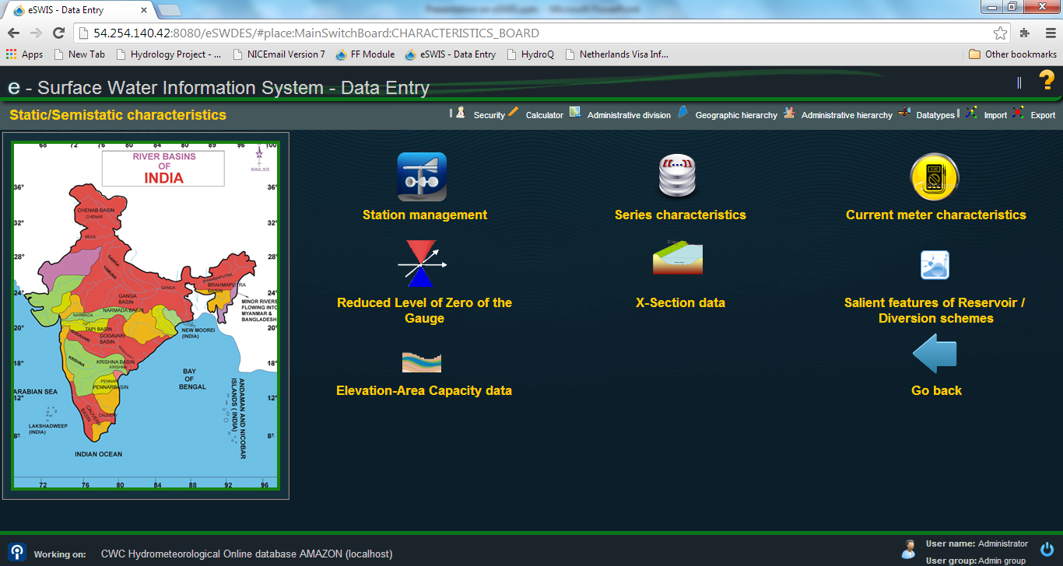
Static/Semistatic Characteristics

Slide 139
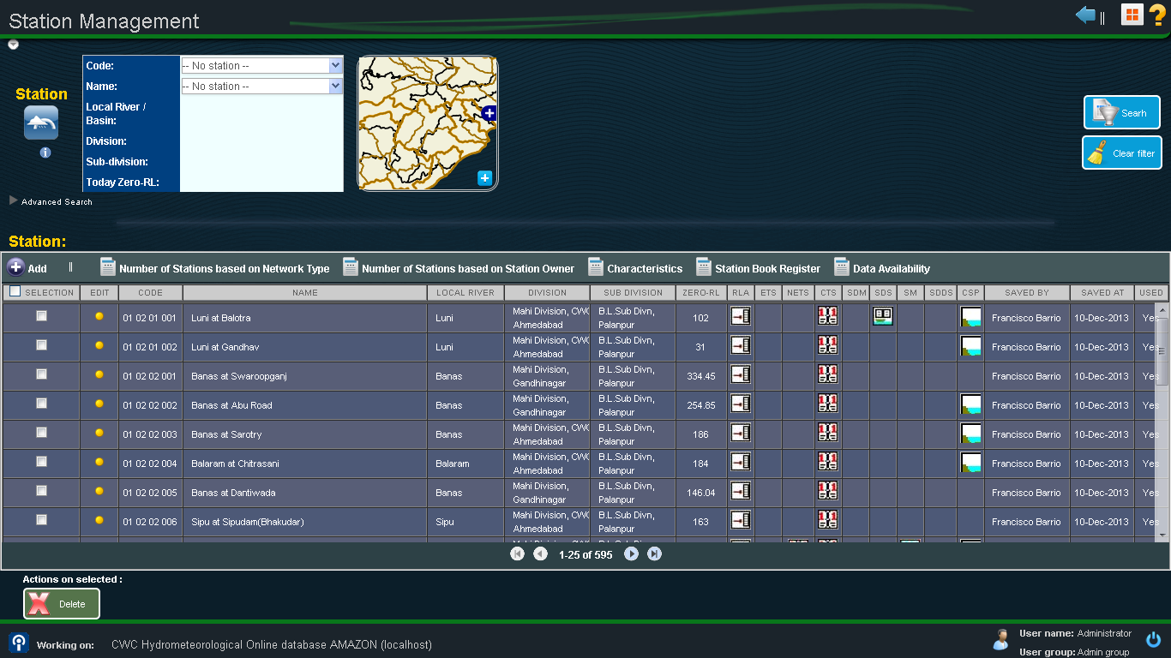
Station management

Slide 140
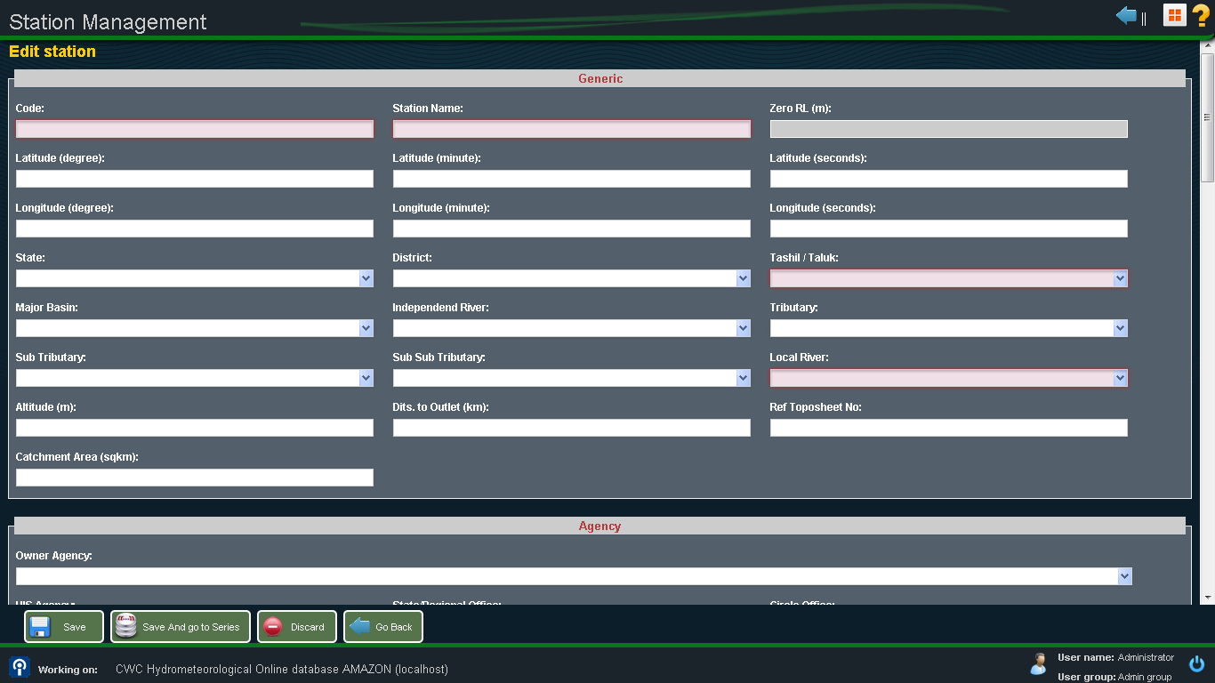
Station management

Slide 141
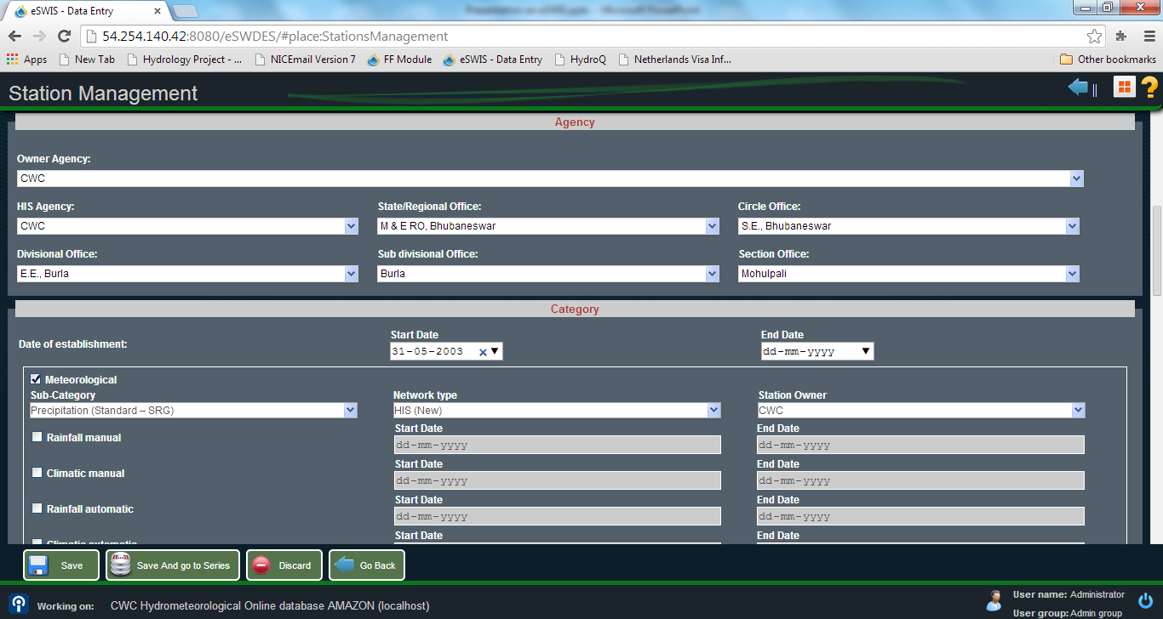
Station Management

Slide 142
Representation of HO site on Map

Slide 143
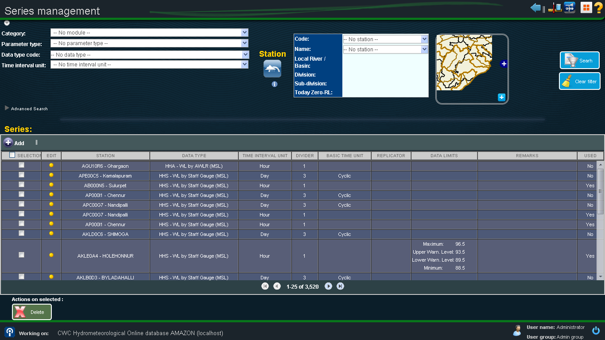
Series management

Slide 144
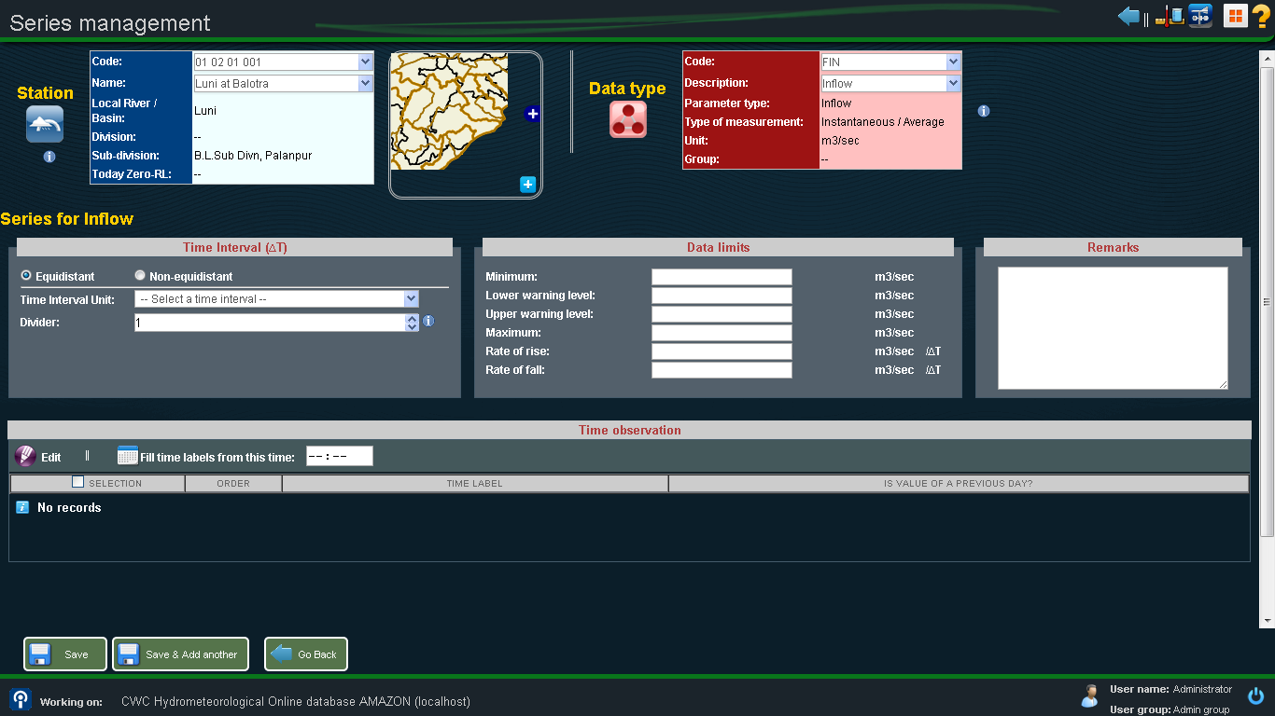
Series management

Slide 145
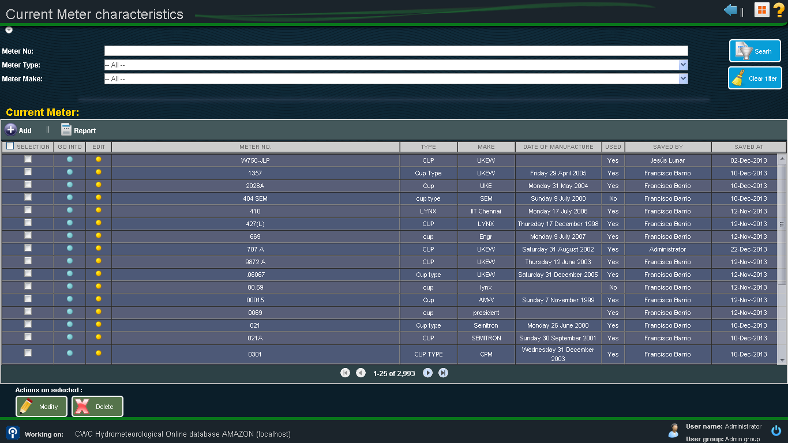
Current Meter

Slide 146
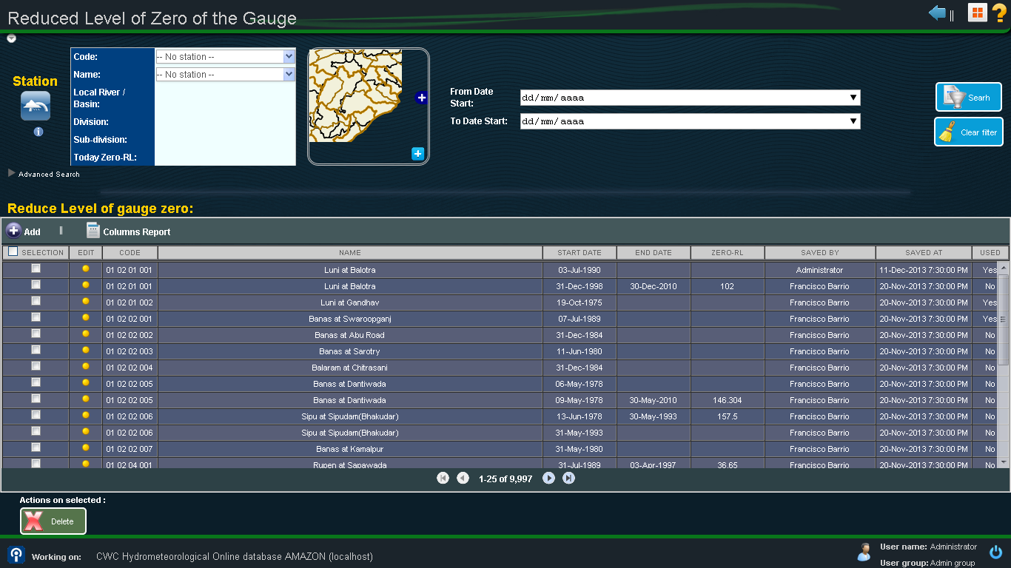
Reduced Level

Slide 147
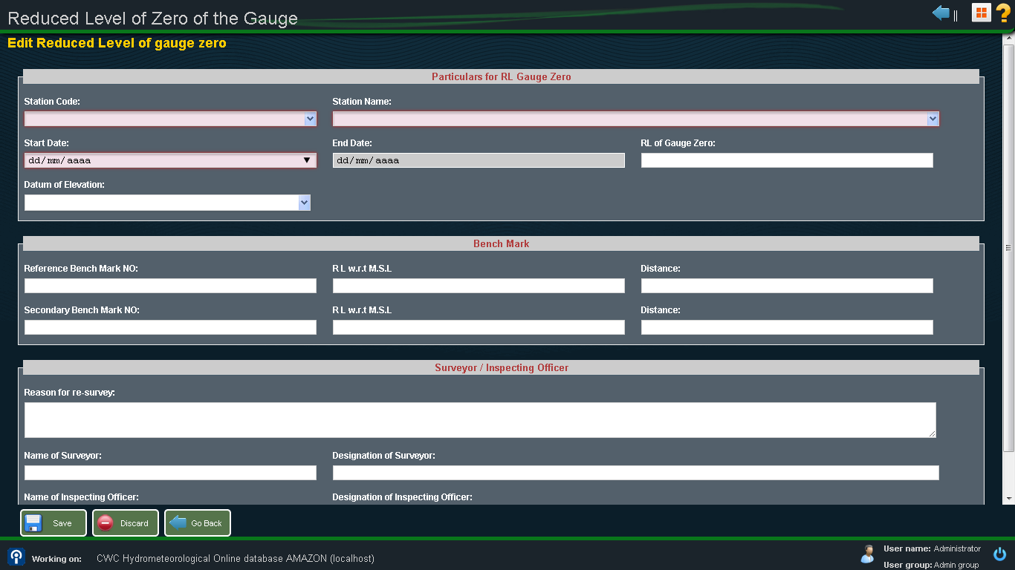
Reduced Level

Slide 148
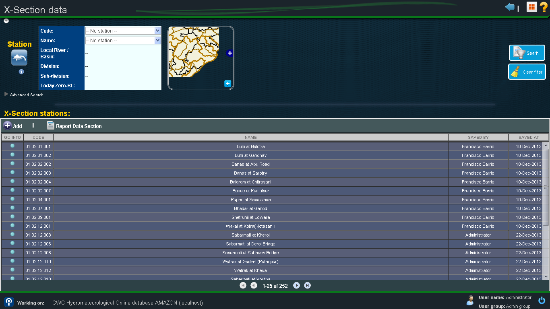
X-Section

Slide 149
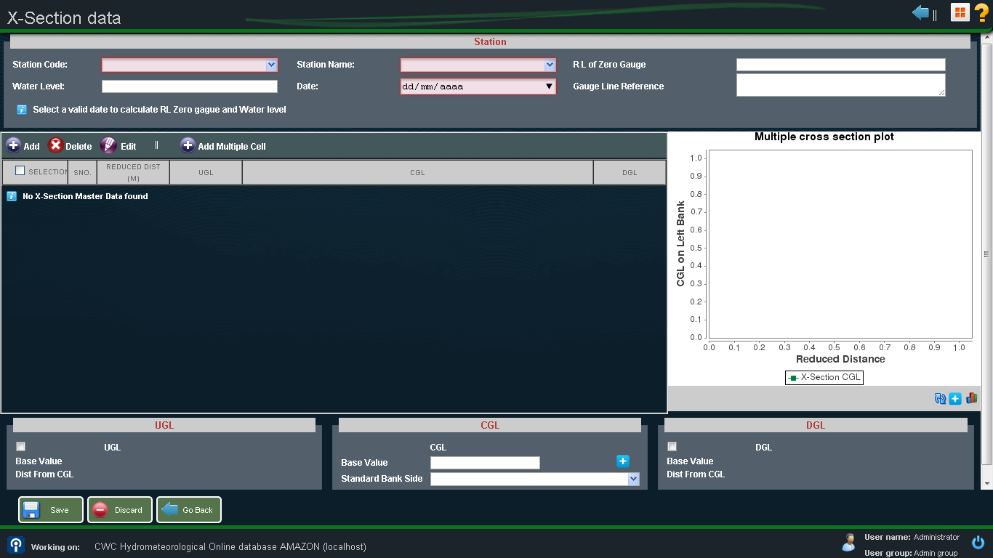
X-Section

Slide 150
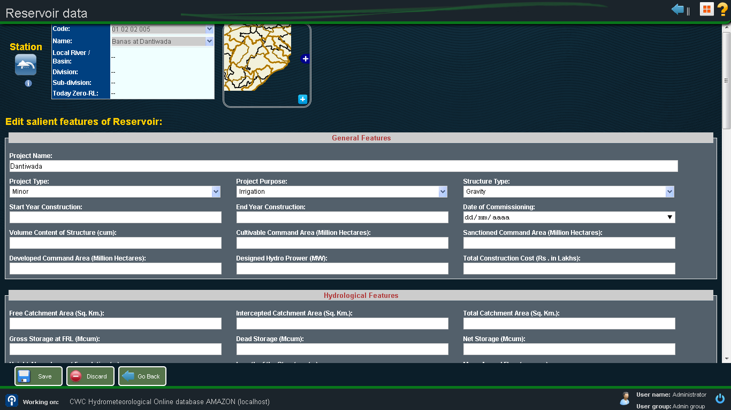
Salient features of Reservoir

Slide 151
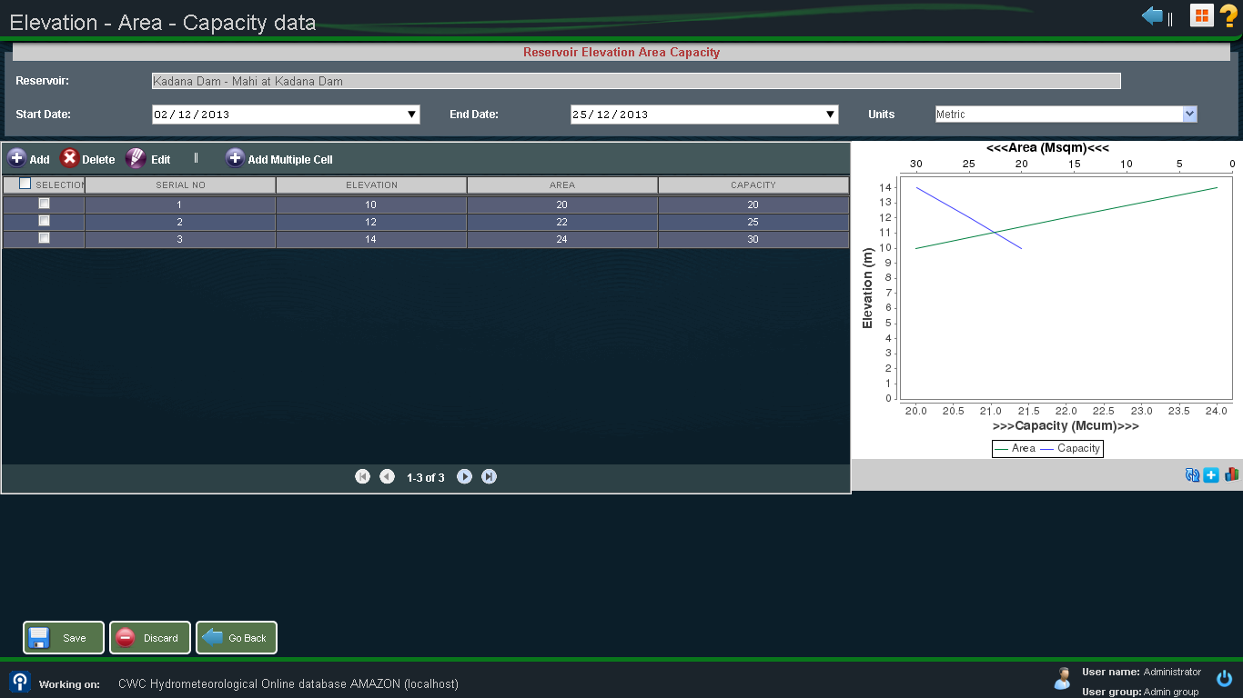
Elevation-Area-Capacity

Slide 152
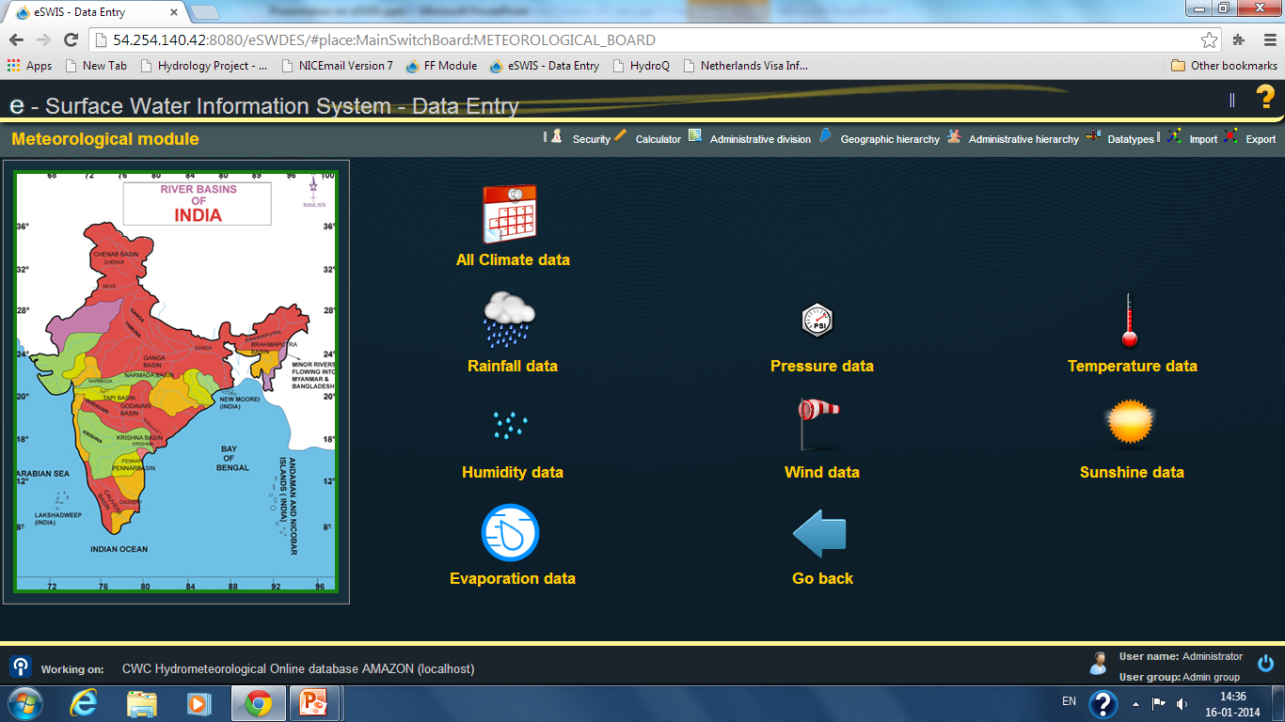
Meteorological Module

Slide 153
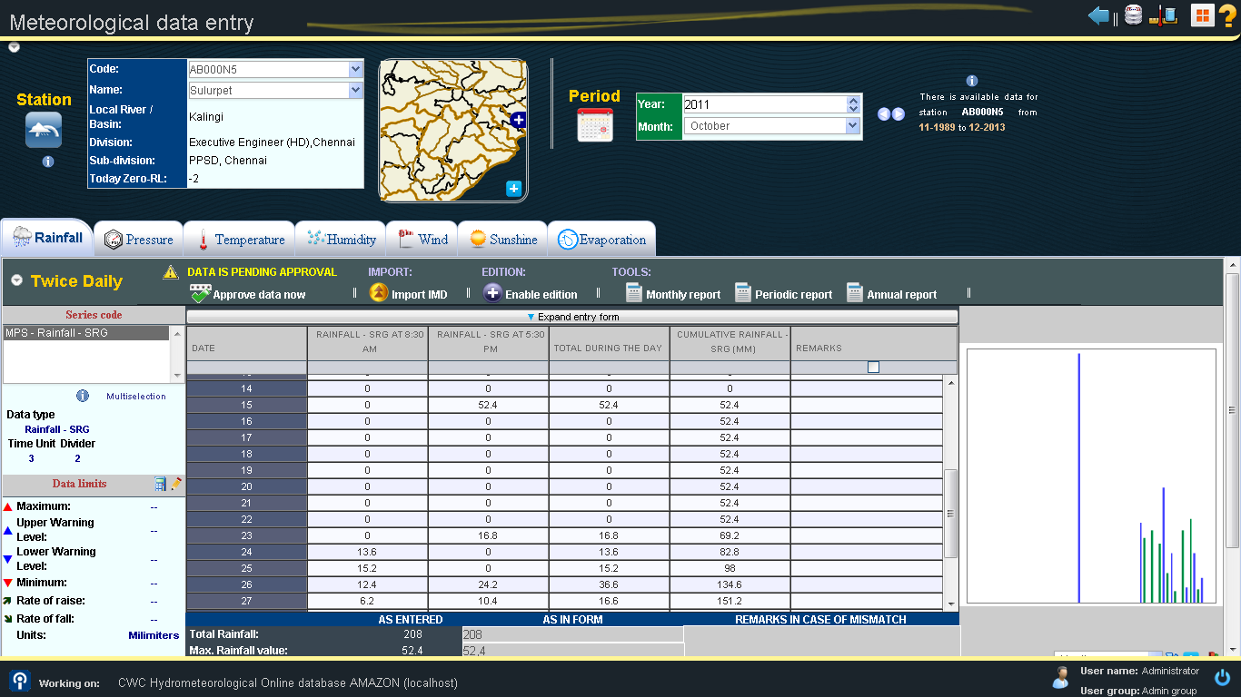
Data Entry - Meteorological module

Slide 154
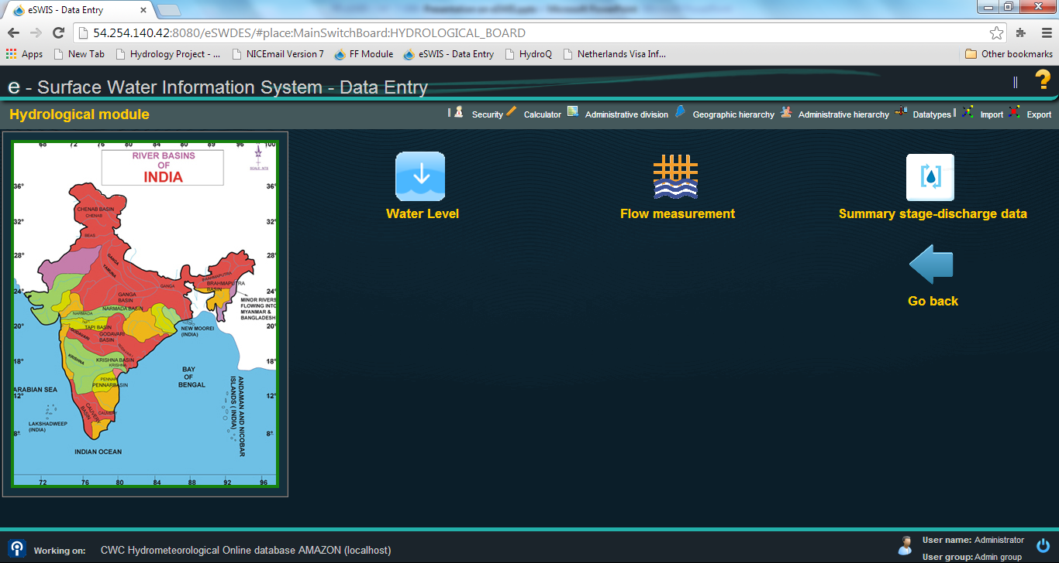
Hydrological Module

Slide 155
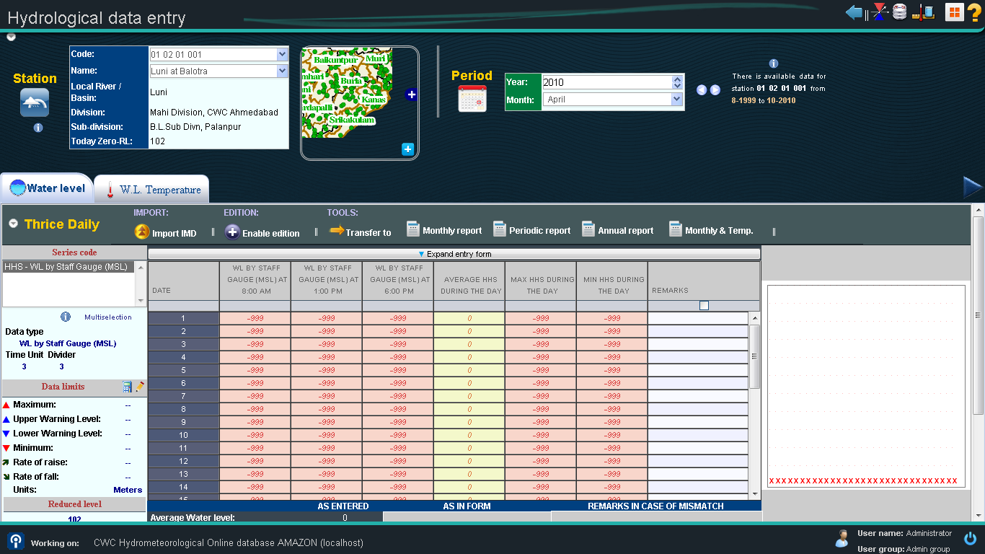
Data Entry - Hydrological module

Slide 156
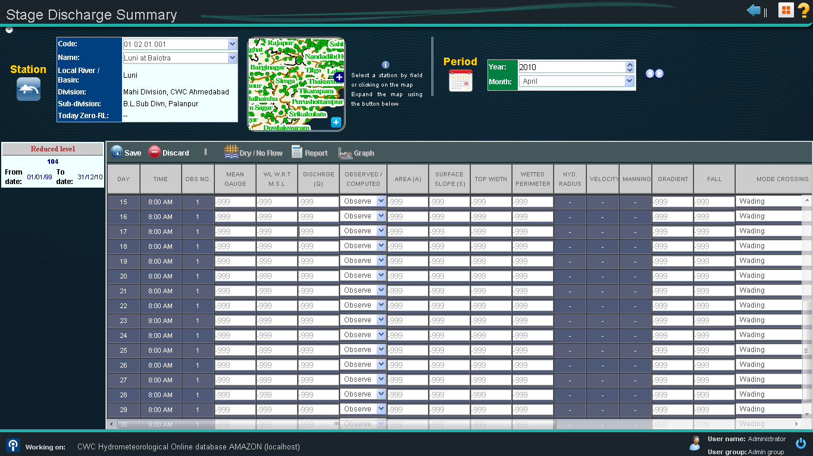
Data Entry - Hydrological module

Slide 157
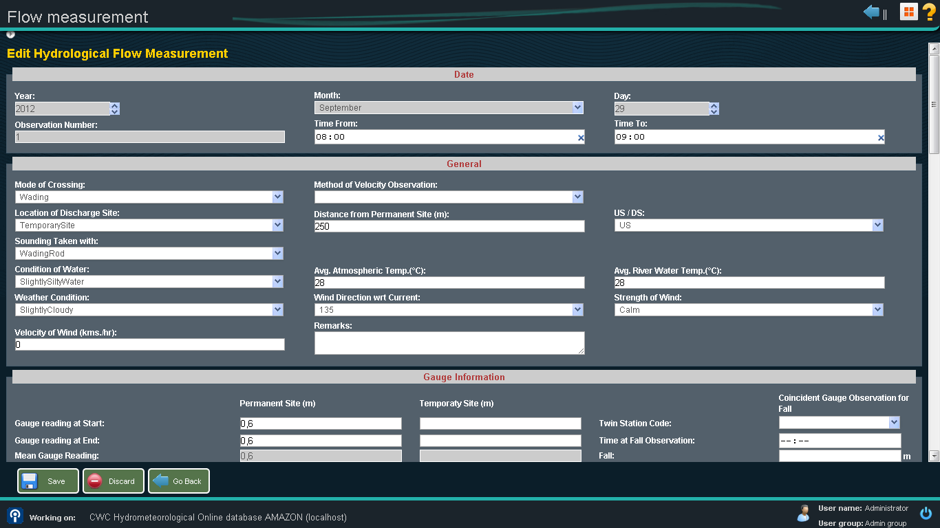
Data Entry - Hydrological module

Slide 158
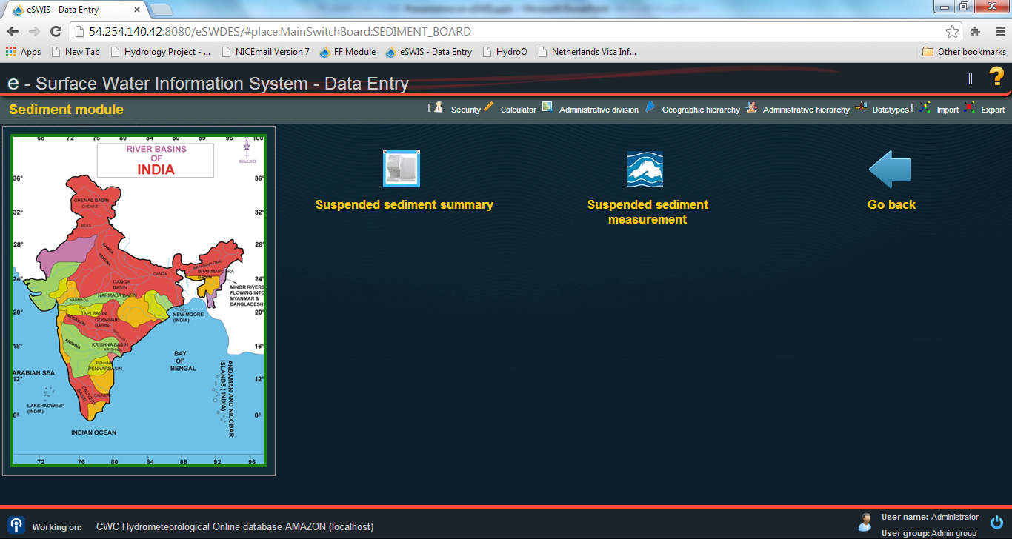
Sediment Module

Slide 159
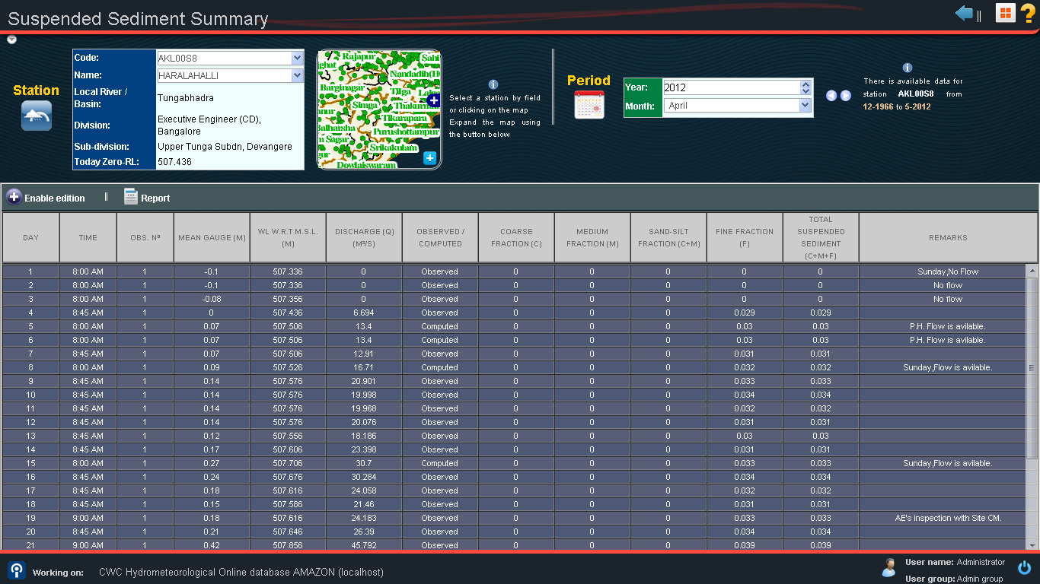
Data Entry - Sediment

Slide 160
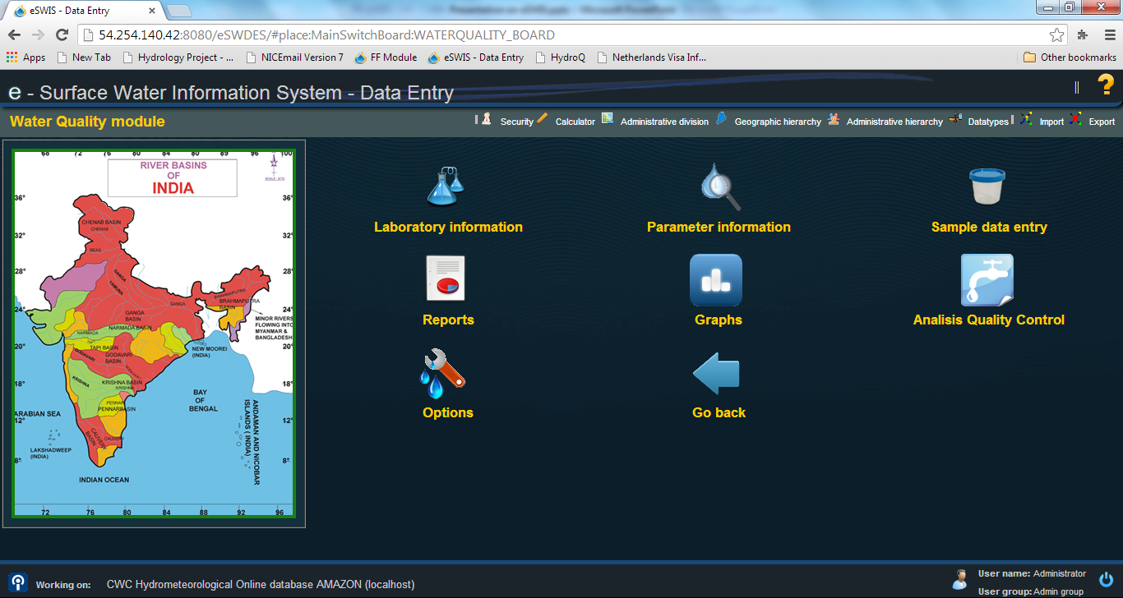
Water Quality Module

Slide 161
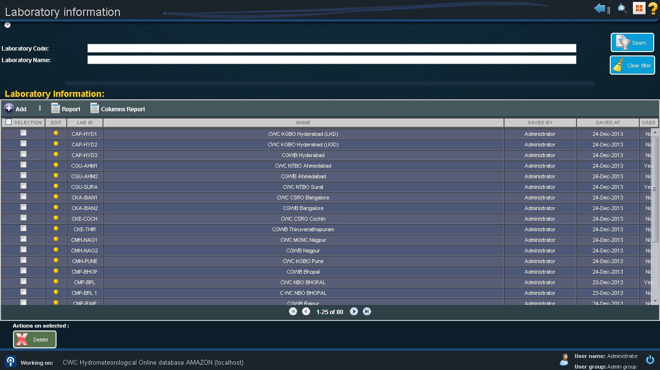
Data Entry – Water Quality

Slide 162
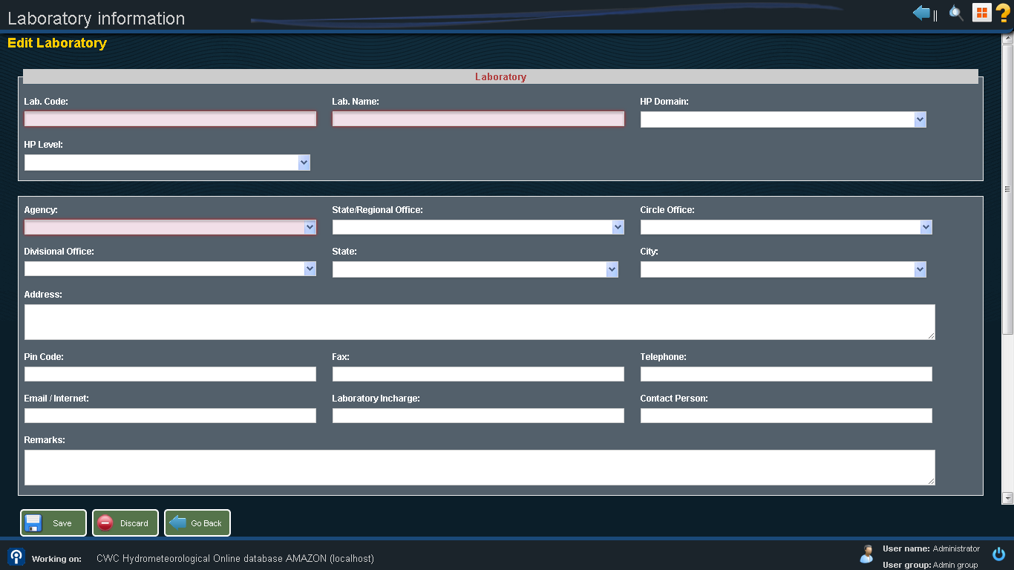
Data Entry – Water Quality

Slide 163
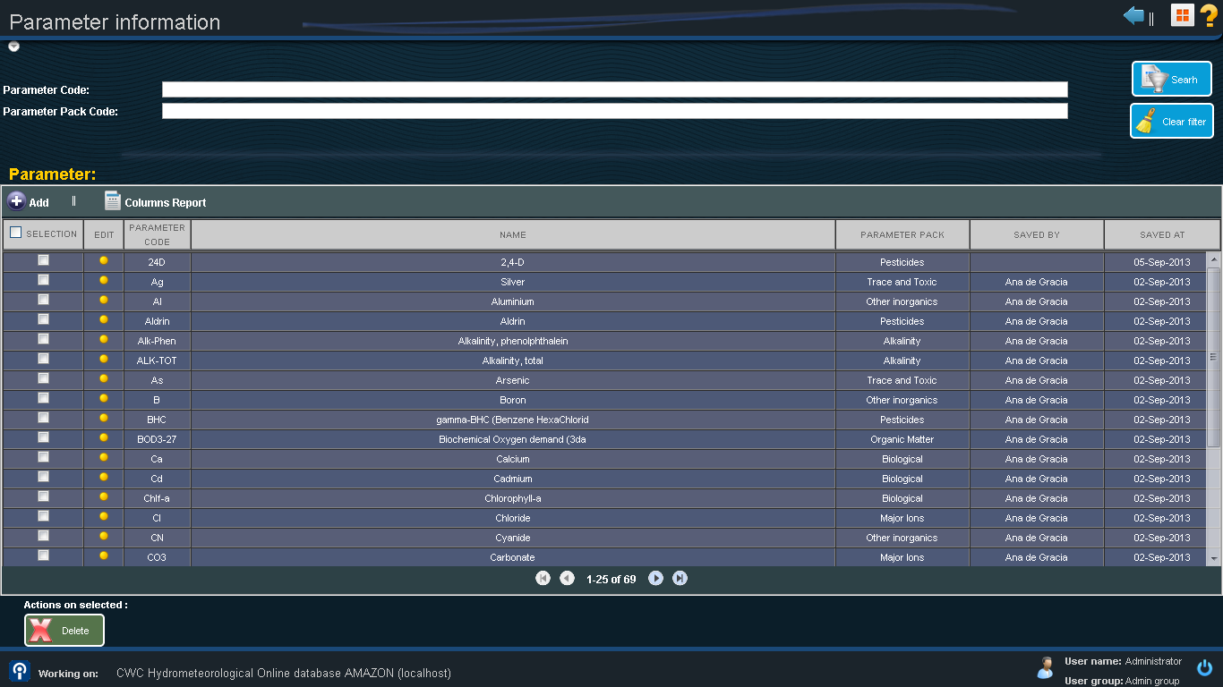
Data Entry – Water Quality

Slide 164
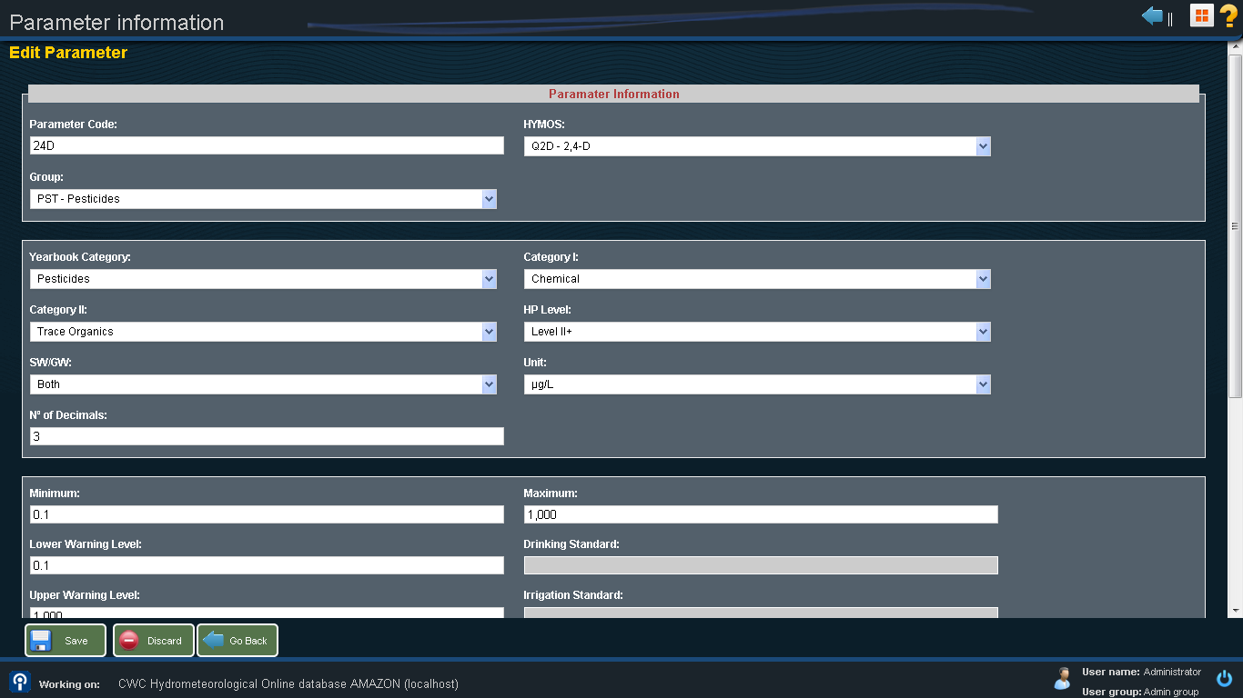
Data Entry – Water Quality

Slide 165
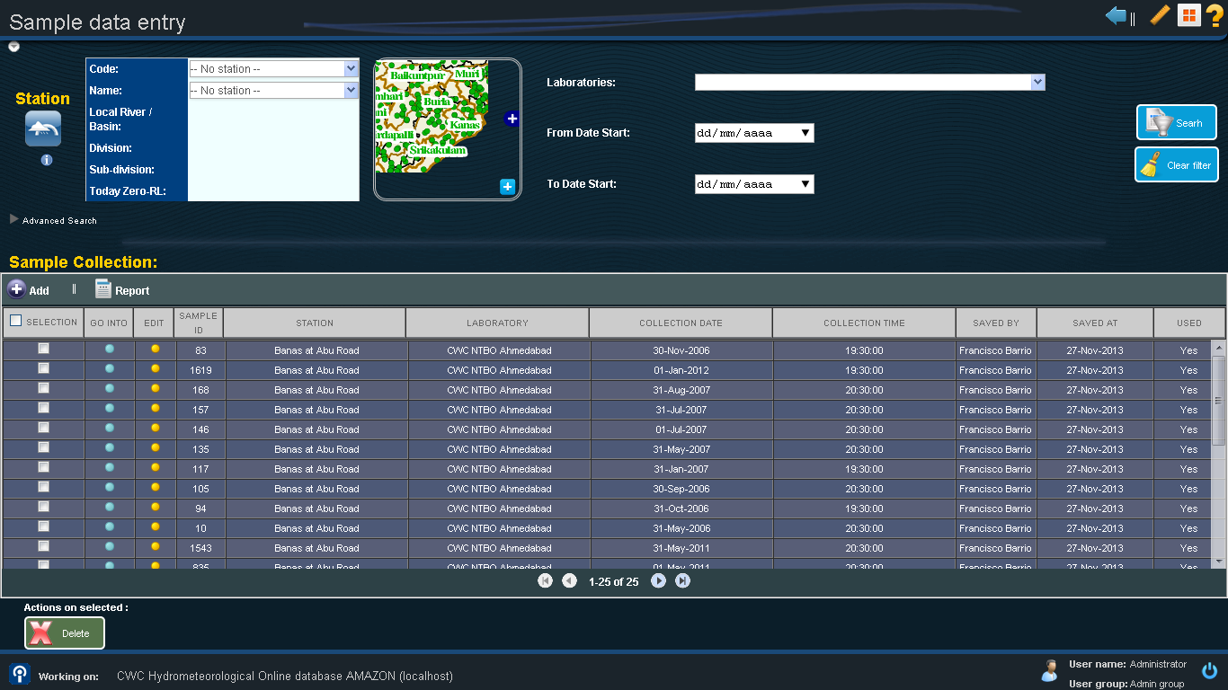
Data Entry – Water Quality

Slide 166
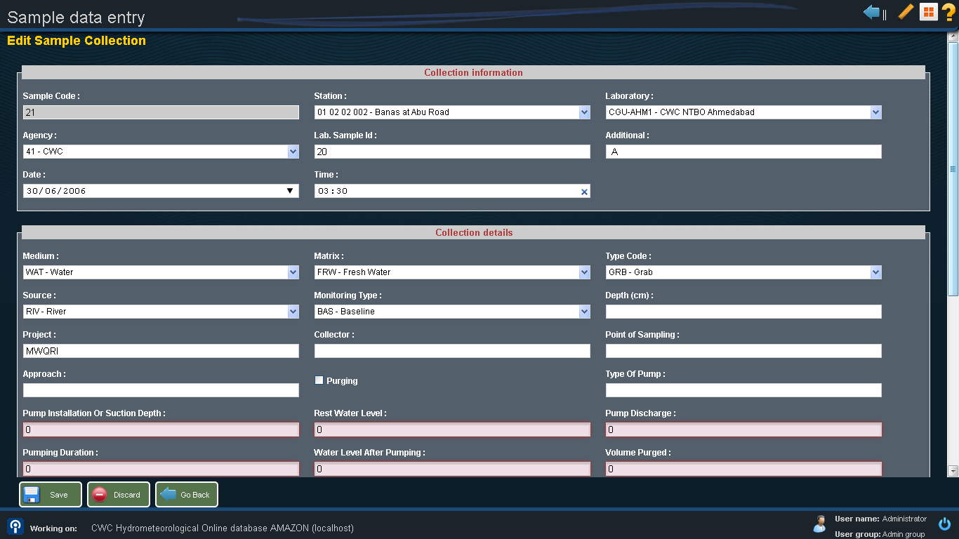
Data Entry – Water Quality

Slide 167
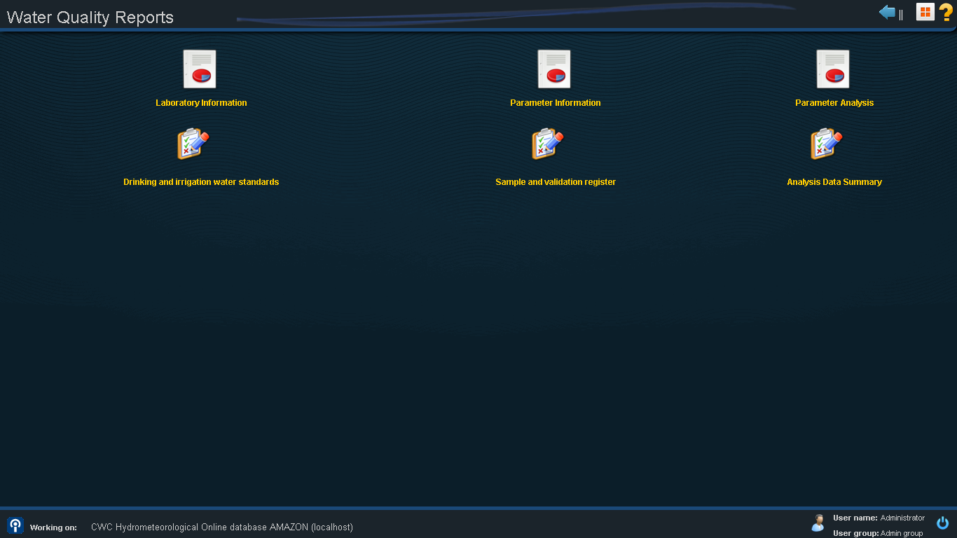
Data Entry – Water Quality

Slide 168
Snow Module

Slide 169
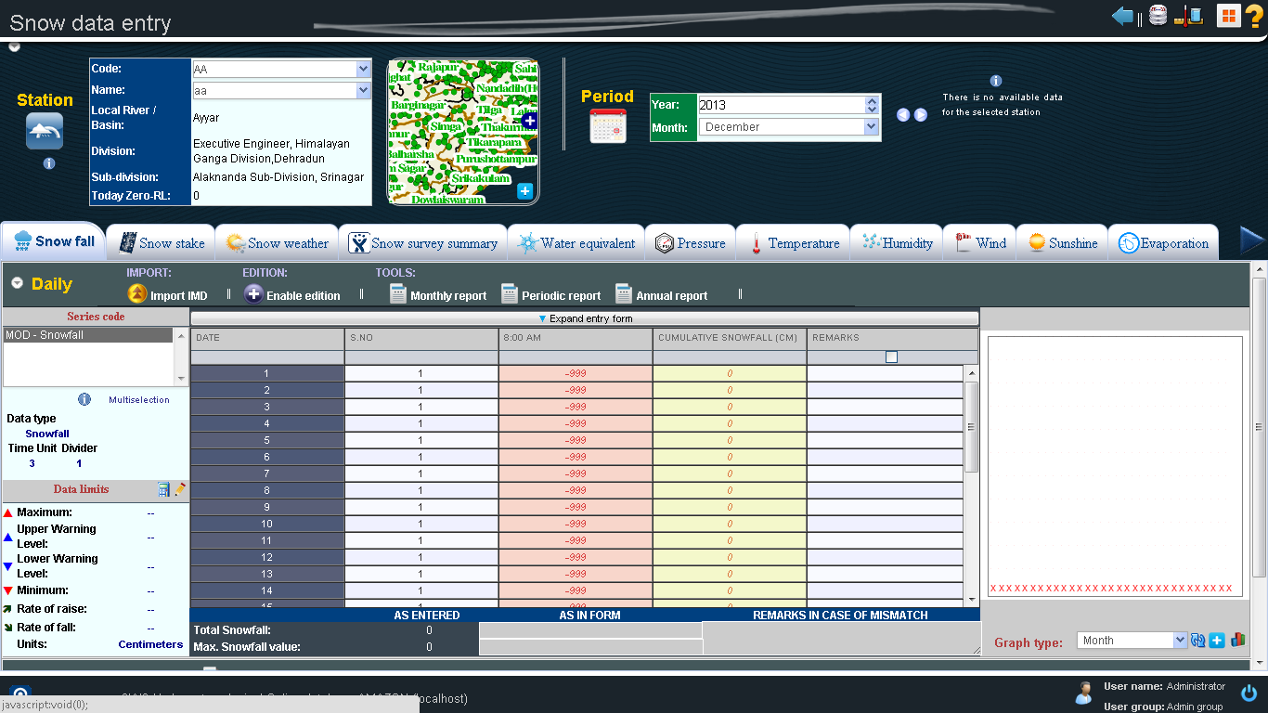
Data Entry – Snow

Slide 170
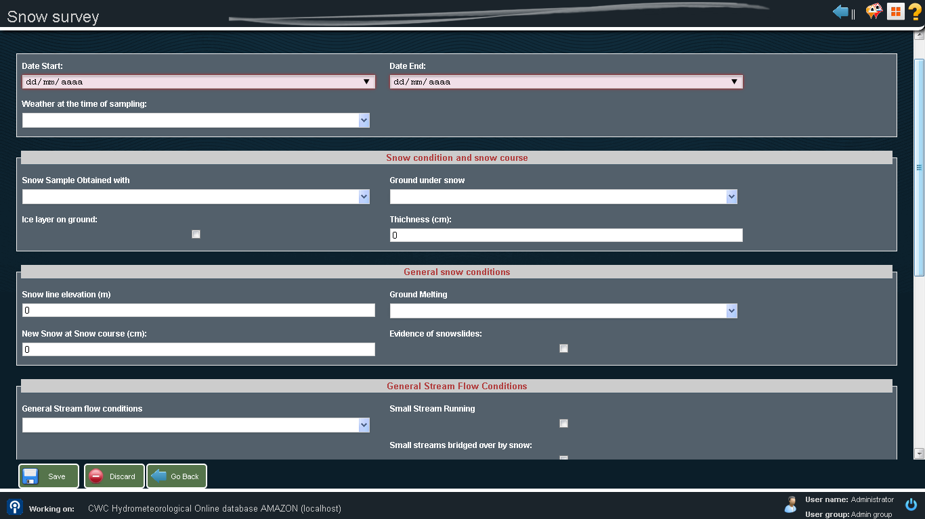
Data Entry – Snow

Slide 171
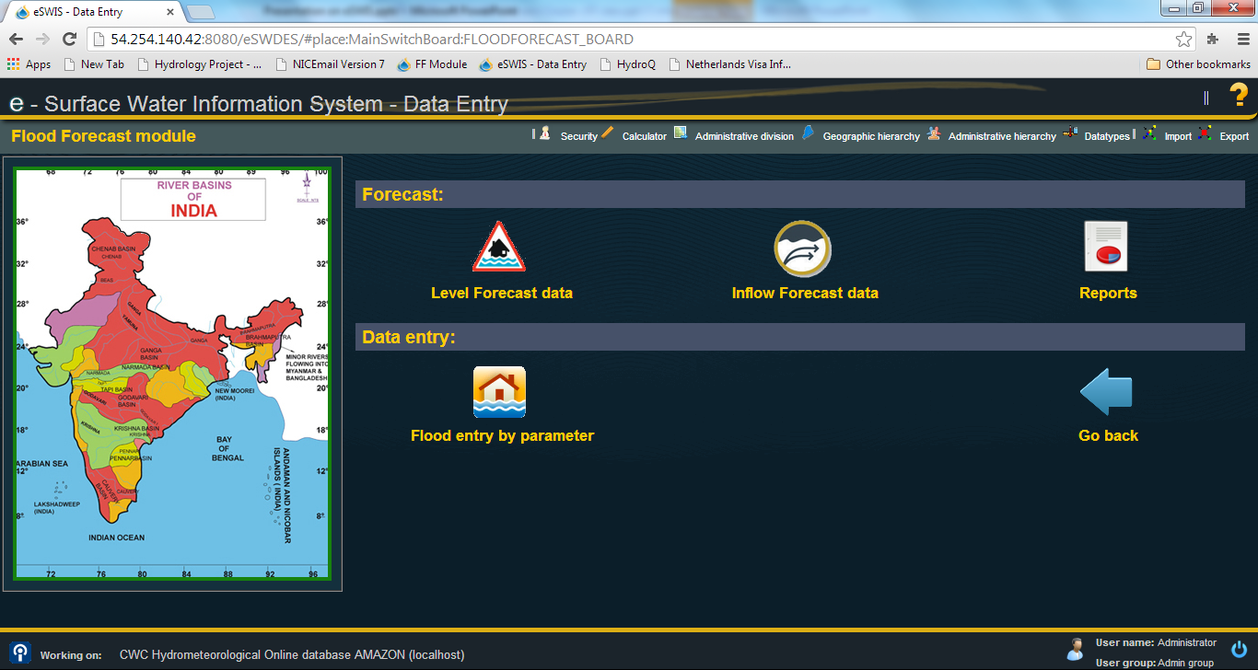
Flood Forecast Module

Slide 172
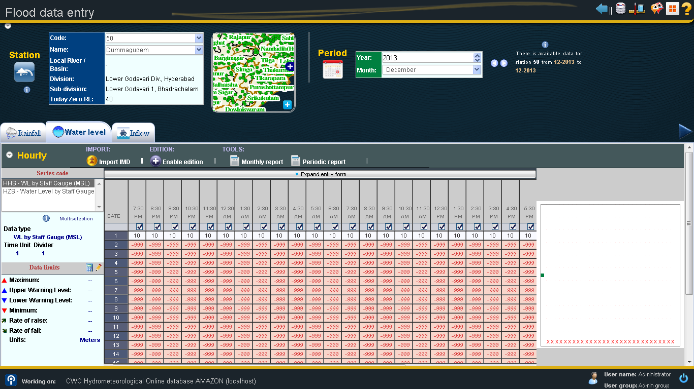
Data Entry – Flood Forecast

Slide 173
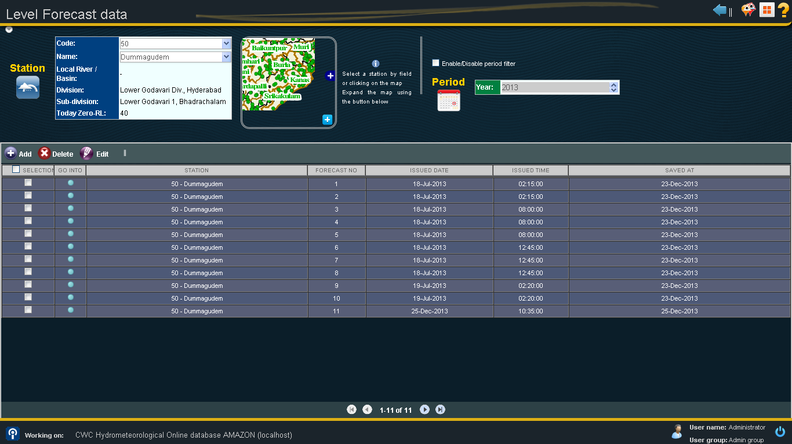
Data Entry – Flood Forecast

Slide 174
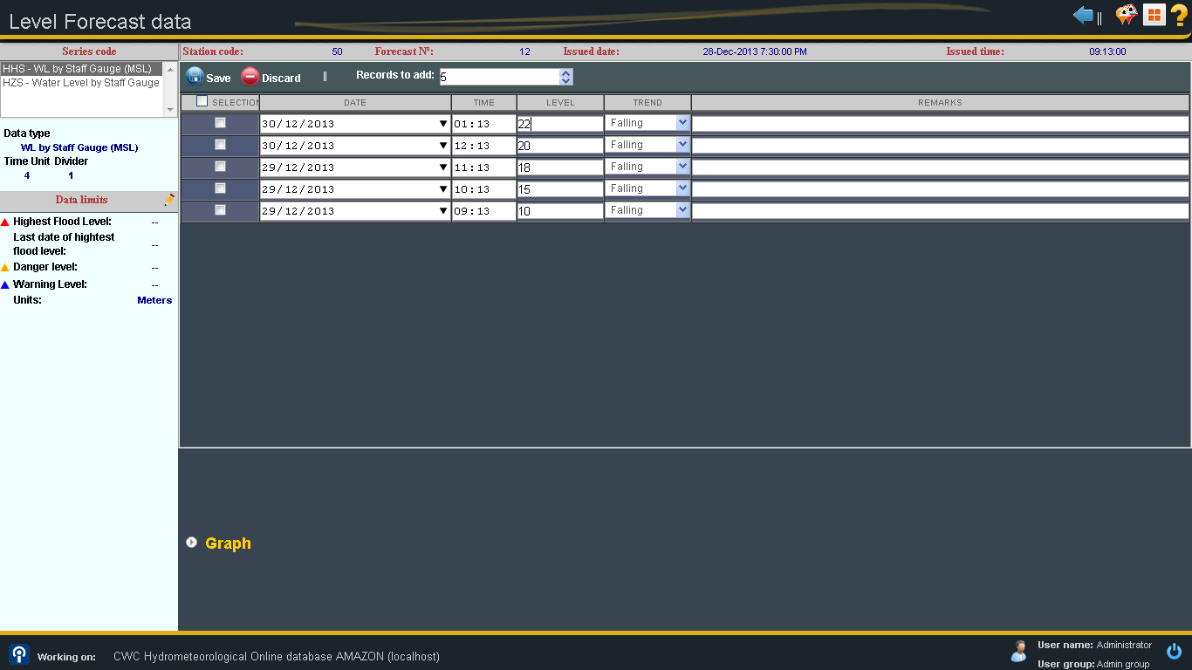
Data Entry – Flood Forecast

Slide 175
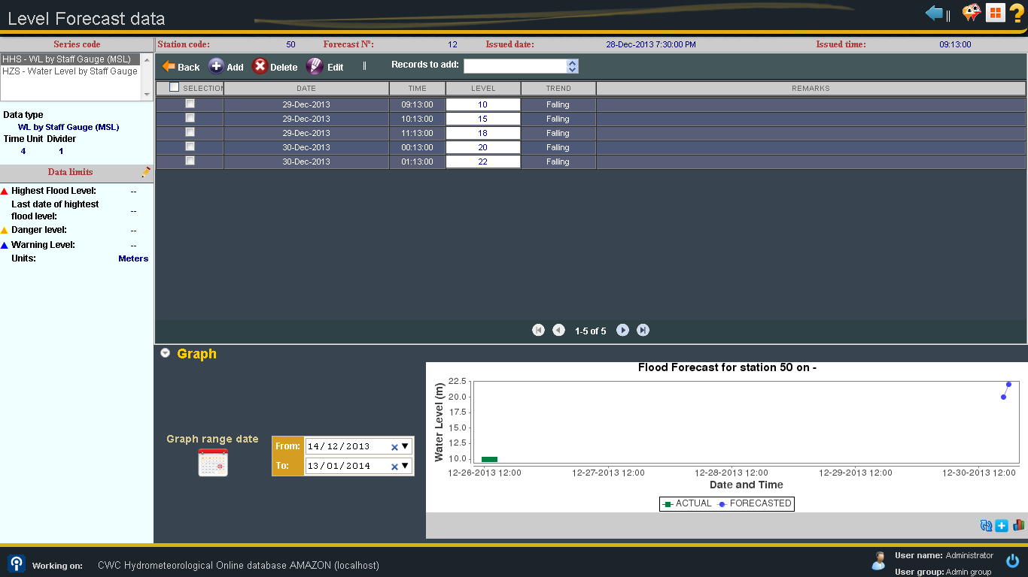
Data Entry – Flood Forecast

Slide 176
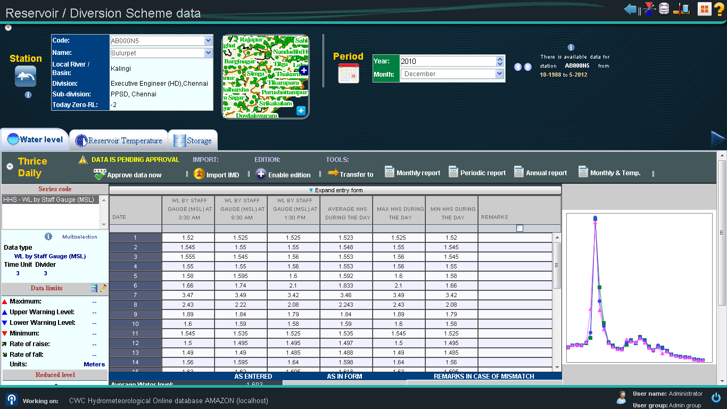
Data Entry – Reservoir / Diversion Scheme data

Slide 177
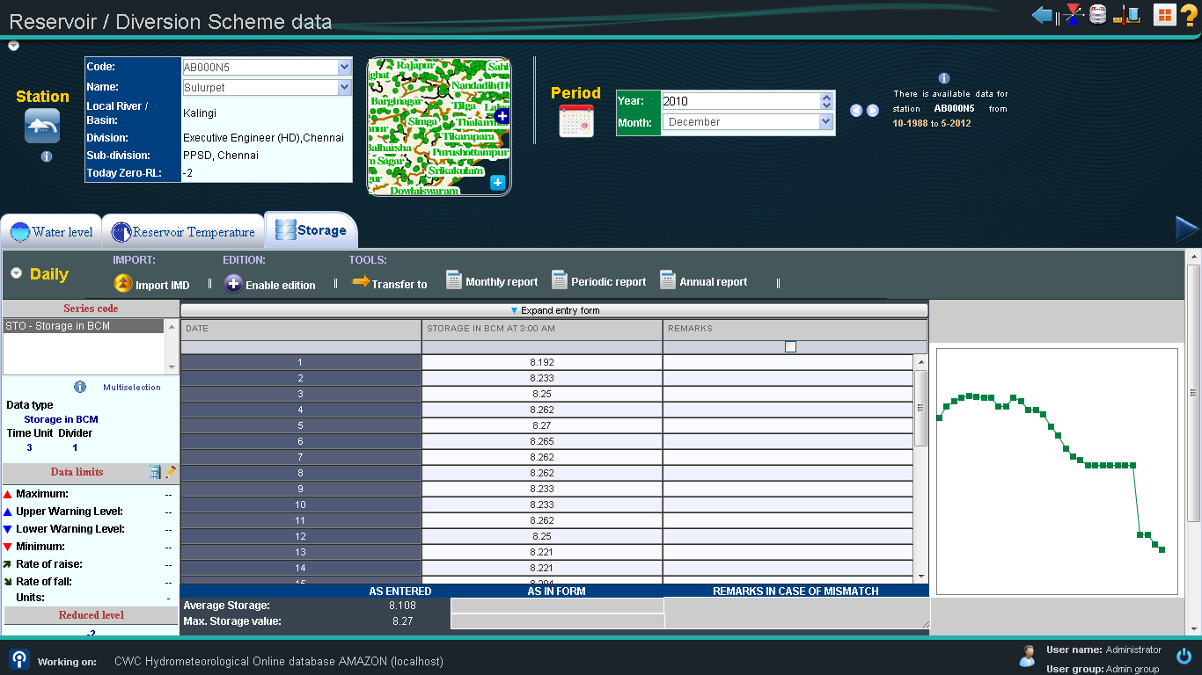
Data Entry – Reservoir / Diversion Scheme data

Slide 178
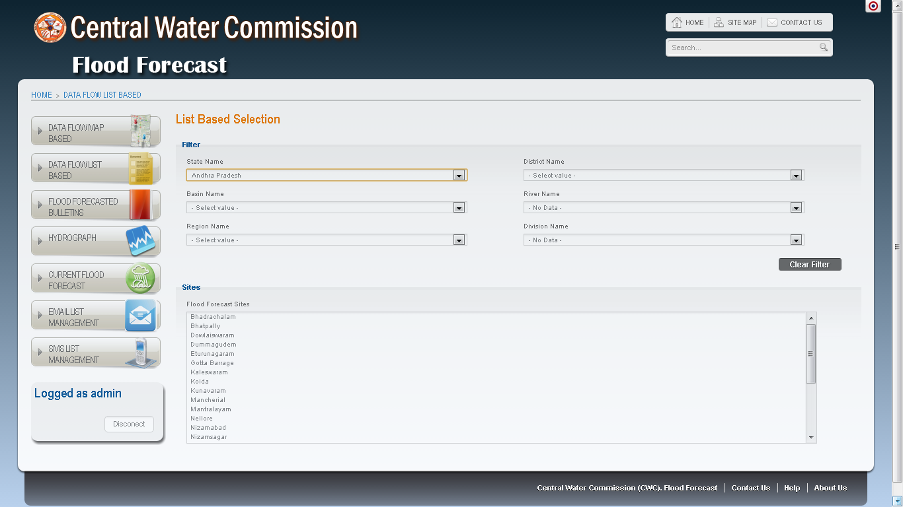
Flood Forecast Web Application

Slide 179
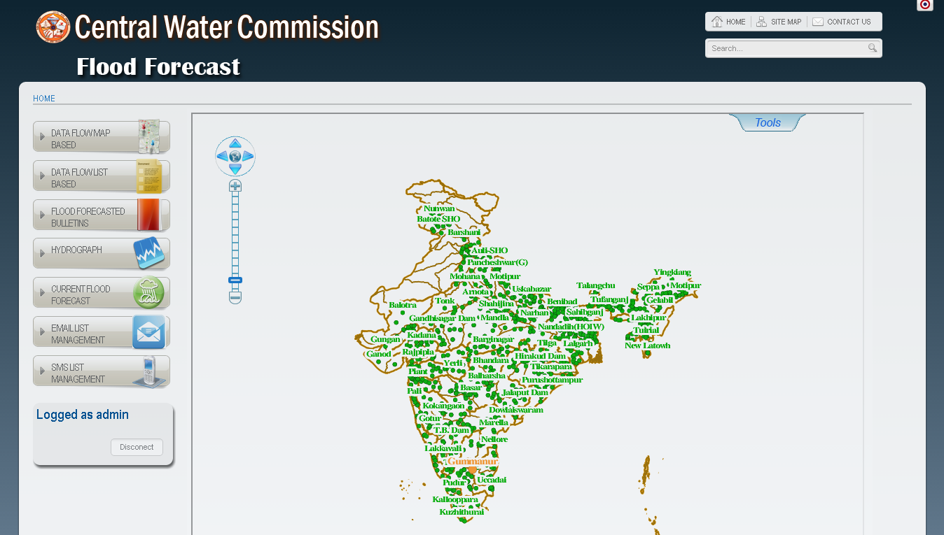
Flood Forecast

Slide 180
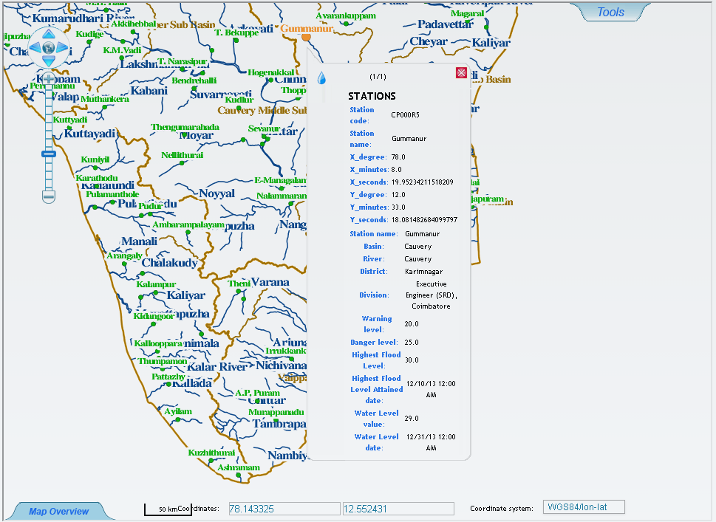
Flood Forecast Web Application

Slide 181
Flood Forecast Web Application

Slide 182
Flood Forecast Web Application

Slide 183
Flood Forecast Web Application

Slide 184
Flood Forecast Web Application

Slide 185
Flood Forecast Web Application

Slide 186
System Architecture
All databases will be managed using PostgreSQL. Open-source database which:
Is scaleable as the number of CPUs and amount of RAM increase.
Stores GIS information installing the component PostGIS spatial
PostGIS will be the Spatial Database Management System which is plugin for PostgreSQL
Both libraries and web services will be developed using Java 1.6
In order to support most features of Java, application server will be Apache-Tomcat: J2EE application-server opensource

